Slide 1
KENYAN PRIMARY & JUNIOR SECONDARY SCHOOLS
Somesha for Schools: Operational Manual
Complete Institutional Management & CBC Academic System Guide
A Step-by-Step Feature-by-Feature Guide to Running a Modern, Paperless, CBC-Compliant Kenyan School
100% Free School ERP
Zero licensing costs or software setup fees for Kenyan Primary & JSS institutions.
Complete CBC Compliance
Pre-Primary, Primary & JSS assessment rubrics, 4-tier competencies & report cards.
Instant M-Pesa Fee STK Push
Direct parent mobile phone prompts, automatic reconciliation & zero cash handling.
Target Audience: School Directors, Principals, Headteachers, Teachers, Bursars & BOM | Platform URL: https://somesha.cloud | Release: 2026 Comprehensive Edition

Slide 2
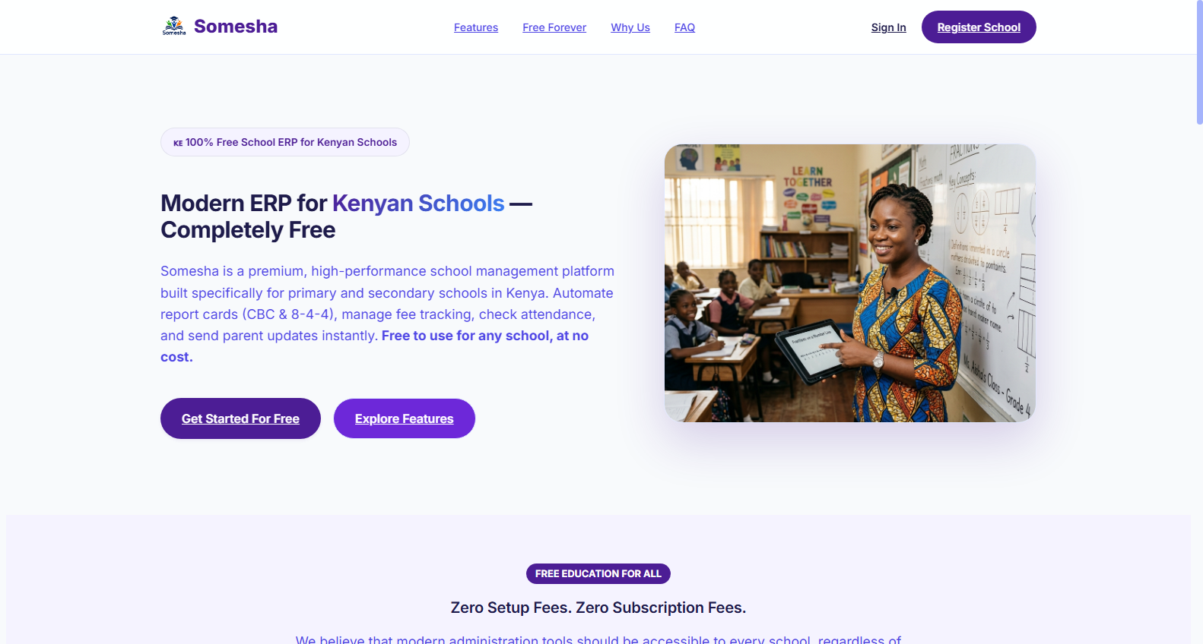
INSTITUTIONAL OVERVIEW
Why Kenyan Schools Choose Somesha
Eliminating administrative chaos, fee defaults, and manual paperwork with a zero-cost cloud solution.
Zero Cost Barrier for Schools
Free to adopt for public and private primary schools and Junior Secondary Schools (JSS)—no server purchase or annual license fees.
🔒 https://somesha.cloud
● Live School View
Tailored for Kenya's CBC System
Pre-configured for PP1 to Grade 9, complete with KICD learning areas, formative/summative rubrics, and automated competency calculations.
Frictionless Mobile Finance
Automates tuition fee collection via Safaricom M-Pesa STK push directly to parents' phones, providing immediate receipts and tamper-proof ledgers.
📋 Step-by-Step School Workflow:
1. Visit https://somesha.cloud on any mobile phone, tablet, or desktop computer.
2. Click 'Register School' and enter basic details in under 3 minutes.
3. Log in immediately to access your dedicated school administration workspace.
🎯 Value for School Headteachers & BOM
Cuts school administrative overhead by over 70%, giving school heads more time to focus on academic excellence.
Somesha School Portal • Role-Based Access • Encrypted Live Sync

Slide 3
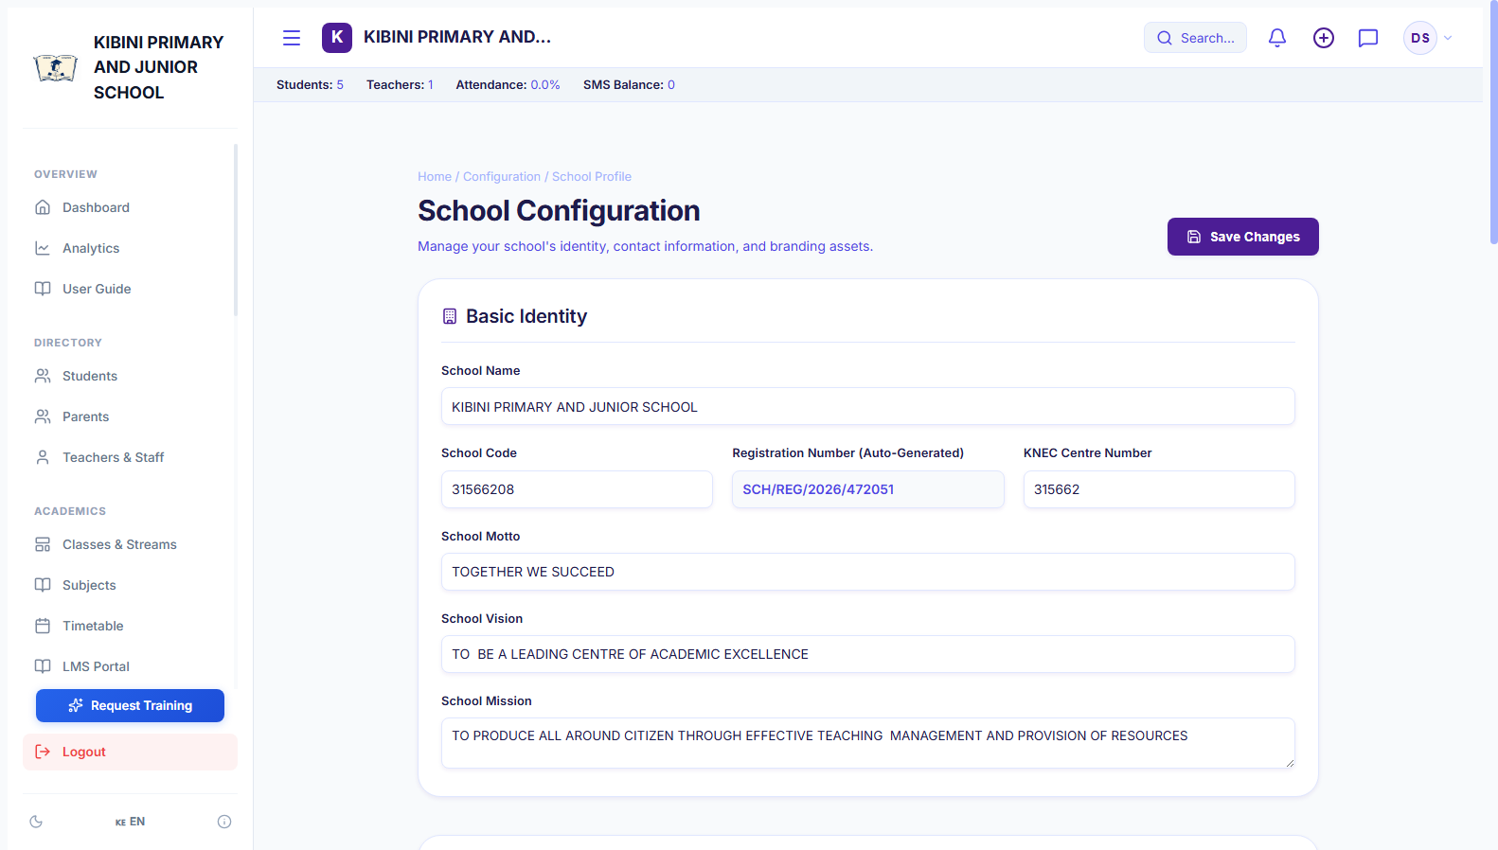
INSTITUTIONAL IDENTITY
School Profile, Branding & Crest Setup
Personalize your school's digital identity, report card headers, and official documents.
Official Crest & Logo Upload
Upload your school emblem, which automatically appears on report cards, fee invoices, student IDs, and leaving certificates.
🔒 https://somesha.cloud/dashboard/school-profile
● Live School View
Institutional Details & Contacts
Set official school name, postal address, physical county/sub-county, phone numbers, and official email address.
Ministry MOE / NEMIS Code
Store your institution's registration number, KNEC exam center code, and Ministry of Education identifiers for official compliance.
📋 Step-by-Step School Workflow:
1. Navigate to 'Settings' > 'School Profile' from the main dashboard navigation.
2. Upload school crest image and enter school motto, address, and contact lines.
3. Click 'Save Changes' to update all school-branded documents instantly.
🎯 Value for School Headteachers & BOM
Generates polished, dignified report cards and official letters that elevate the school's reputation with parents and Ministry inspectors.
Somesha School Portal • Role-Based Access • Encrypted Live Sync

Slide 4
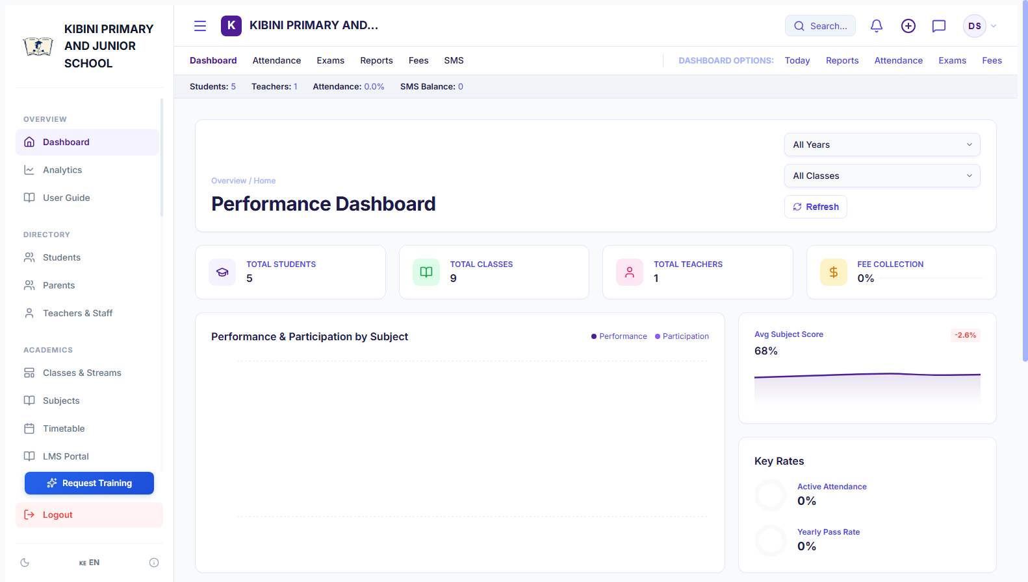
PRINCIPAL OPERATIONS
Daily Administrative Command Center
Your morning dashboard providing instant visibility into every operational aspect of the school.
Live Learner Population Counter
Displays real-time total student headcount broken down across pre-primary, primary, and junior secondary cohorts.
🔒 https://somesha.cloud/dashboard
● Live School View
Fee Collection Performance
Visual breakdown of total term fees invoiced, total payments collected via M-Pesa/Bank, and outstanding balances.
Quick Administrative Shortcuts
Single-click action buttons to admit a new student, take attendance, post circulars, or generate end-term reports.
📋 Step-by-Step School Workflow:
1. Log in each morning to review the school's operational summary widget.
2. Check attendance alerts to identify absent students early in the day.
3. Review fee collection progress to follow up on pending term installments.
🎯 Value for School Headteachers & BOM
Empowers the Principal and BOM to make informed operational decisions each morning without sifting through paper records.
Somesha School Portal • Role-Based Access • Encrypted Live Sync

Slide 5
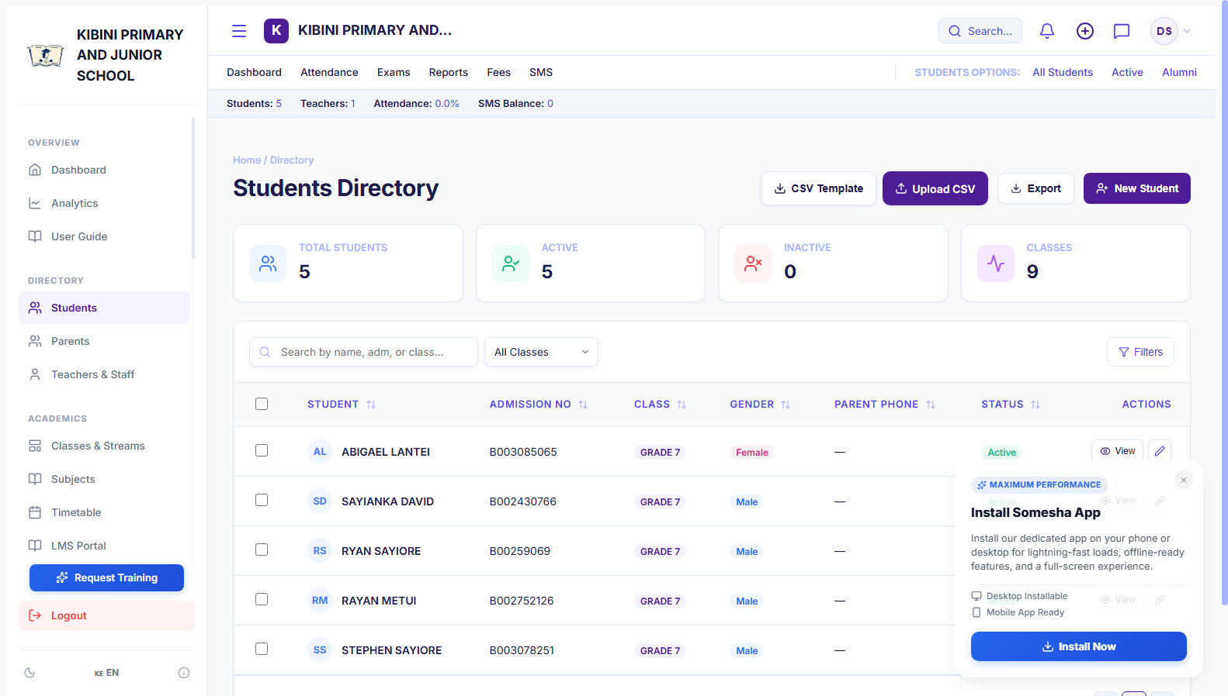
STUDENT INFORMATION SYSTEM
Student Rosters & Lifelong Digital Profiles
A centralized digital filing system capturing complete biographical and academic records.
Comprehensive Learner Profiles
Stores student full names, admission numbers, National UPI / NEMIS identifiers, date of birth, gender, and medical notes.
🔒 https://somesha.cloud/dashboard/students
● Live School View
Parent & Emergency Linking
Every student profile links directly to father, mother, or guardian contact numbers for instant communications.
Bulk Spreadsheet Import (CSV)
Enables importing hundreds of students in a single click from existing Excel sheets, mapping classes and admission numbers.
📋 Step-by-Step School Workflow:
1. Click '+ Add Student' for single admissions or 'Import CSV' for bulk cohort setup.
2. Fill in admission number, full name, class, gender, and guardian telephone number.
3. Use the real-time search bar to look up any learner by name or admission number in 1 second.
🎯 Value for School Headteachers & BOM
Permanently eliminates lost student admission files and enables instant retrieval of records even years after graduation.
Somesha School Portal • Role-Based Access • Encrypted Live Sync

Slide 6
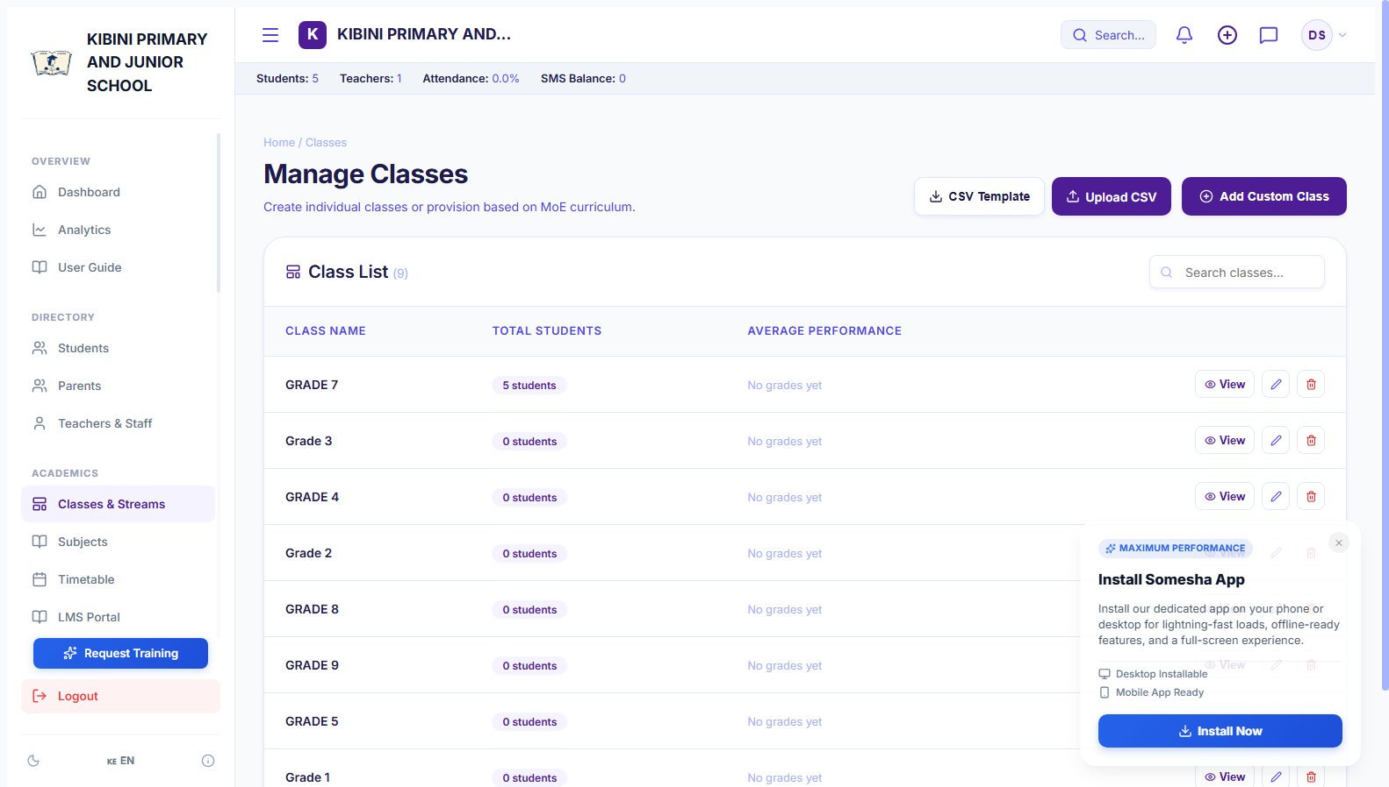
ACADEMIC MANAGEMENT
CBC Classes, Streams & Cohort Management
Manage Kenya's 2-6-3-3-3 educational tiers with flexible stream allocations.
Support for All CBC Tiers
Pre-configured for Pre-Primary (PP1, PP2), Primary (Grades 1-6), and Junior Secondary School (JSS Grades 7-9).
🔒 https://somesha.cloud/dashboard/classes
● Live School View
Multiple Stream Handling
Create and balance streams (e.g. Grade 7 East, Grade 7 West, Grade 8 Blue) with capacity monitoring.
Class Teacher Allocation
Designate an assigned Class Teacher for each stream who manages attendance, registers marks, and writes report remarks.
📋 Step-by-Step School Workflow:
1. Go to 'Classes' and click '+ Create Class' to add a new level or stream.
2. Select the academic level (e.g. JSS Grade 7) and assign a stream name (e.g. East).
3. Assign the class teacher and set maximum student capacity to prevent overcrowding.
🎯 Value for School Headteachers & BOM
Maintains orderly classroom allocations and optimal student-to-teacher ratios compliant with Ministry of Education directives.
Somesha School Portal • Role-Based Access • Encrypted Live Sync

Slide 7
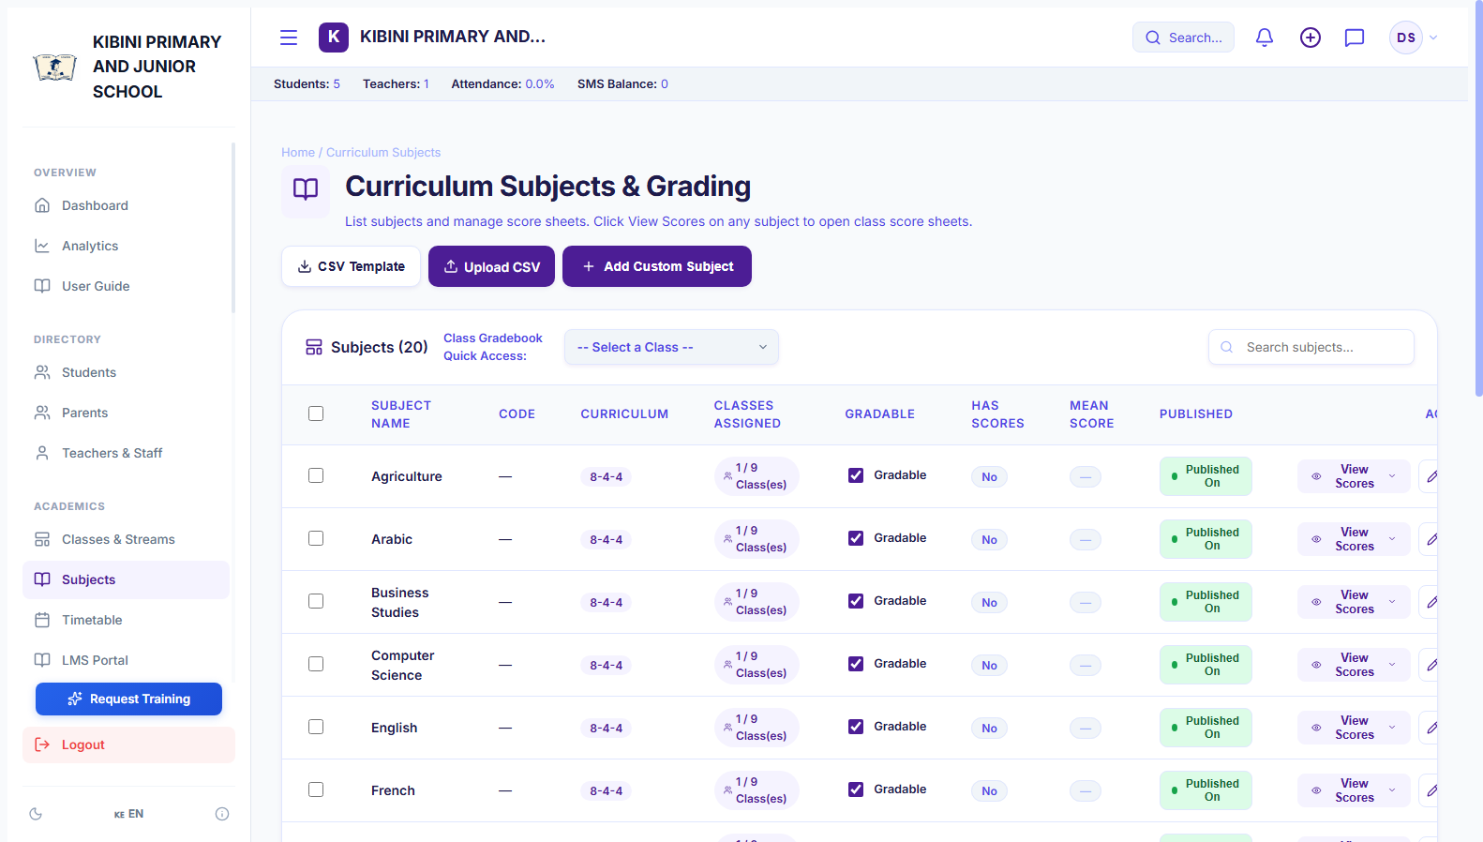
CURRICULUM ARCHITECTURE
KICD Learning Areas & Subject Allocation
Map official Competency-Based Curriculum learning areas to classes and teachers.
Official KICD CBC Subjects
Pre-loaded with official learning areas: Mathematics, English, Kiswahili, Integrated Science, Social Studies, CRE/IRE, Agriculture, Pre-Technical Studies, etc.
🔒 https://somesha.cloud/dashboard/subjects
● Live School View
Subject Teacher Assignment
Pair specific subject teachers to individual streams (e.g. Mr. Kiprop -> Grade 8 Integrated Science).
Custom Learning Areas
Easily add elective or co-curricular areas such as Computer Science, Foreign Languages, Physical Education, or Music.
📋 Step-by-Step School Workflow:
1. Open 'Subjects' to review active learning areas for each grade tier.
2. Click '+ Add Subject' or edit existing subjects to configure passing thresholds.
3. Assign designated subject teachers to ensure they have marks-entry permissions.
🎯 Value for School Headteachers & BOM
Provides curriculum transparency and ensures all KICD mandated learning areas are properly covered by certified staff.
Somesha School Portal • Role-Based Access • Encrypted Live Sync

Slide 8
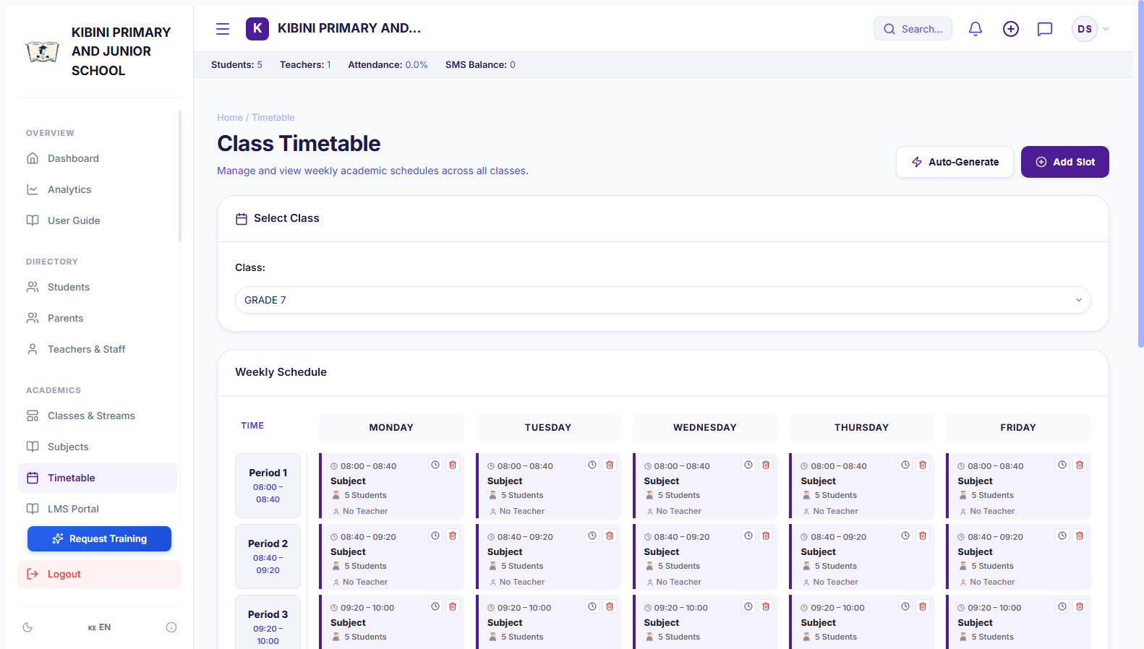
SCHOOL SCHEDULING
Master Timetable & Lesson Allocation
Conflict-free scheduling of lessons, teacher periods, and classroom routines.
Automated Conflict Prevention
Ensures no teacher is assigned to two different classes at the same time and prevents double-booking.
🔒 https://somesha.cloud/dashboard/timetable
● Live School View
Day & Period Customization
Configure 8 or 9 daily lesson slots, morning assemblies, tea breaks, lunch hours, and games periods.
Printable & Mobile Access
Teachers and students can check their daily lesson timetables directly from their mobile phones or print master wall charts.
📋 Step-by-Step School Workflow:
1. Open 'Timetable' and choose the target class and day of the week.
2. Assign subjects and teachers to each 40-minute lesson slot.
3. Click 'Export / Print' to generate clean wall timetables for staffrooms and classrooms.
🎯 Value for School Headteachers & BOM
Prevents teacher clashing, ensures complete syllabus coverage, and establishes orderly school-wide discipline.
Somesha School Portal • Role-Based Access • Encrypted Live Sync

Slide 9
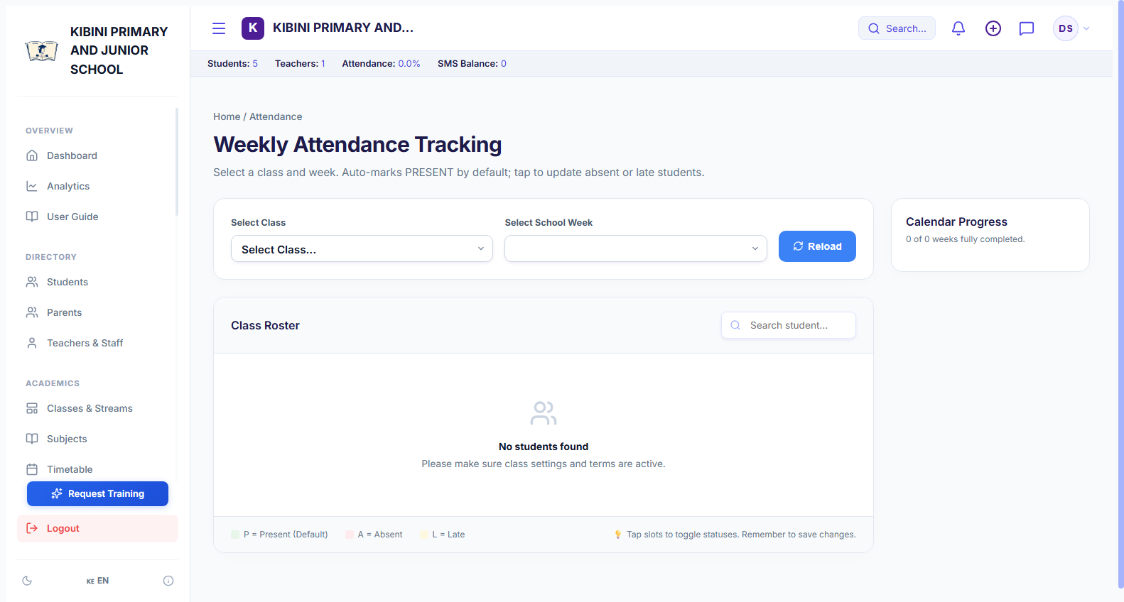
STUDENT WELFARE
1-Click Daily Attendance & Truancy Tracker
Morning roll call taken in under 60 seconds with automated absenteeism warnings.
Interactive Weekly Roster
Teachers take roll call on mobile or PC with one tap: Present (green), Absent (red), Late (yellow), or Excused (blue).
🔒 https://somesha.cloud/dashboard/attendance
● Live School View
Automated Attendance Calculations
Calculates cumulative term attendance percentages for each learner, flagging chronic absenteeism automatically.
Ministry Audit Ready
Generates official monthly and termly attendance registers required during Ministry of Education inspections.
📋 Step-by-Step School Workflow:
1. Class teacher opens 'Attendance' on their phone or tablet at 8:00 AM.
2. Select their assigned class stream and toggle any absent or late learners.
3. Click 'Save Register'—the system updates school records and flags absences immediately.
🎯 Value for School Headteachers & BOM
Protects student safety, improves daily attendance by 15%, and provides indisputable records for guardians and inspectors.
Somesha School Portal • Role-Based Access • Encrypted Live Sync

Slide 10
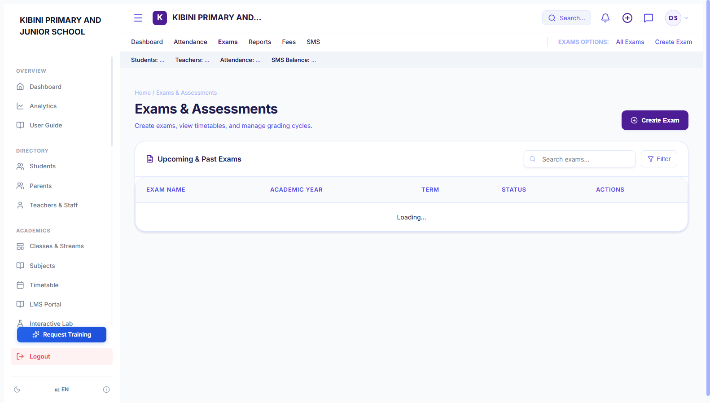
ACADEMIC ASSESSMENT
CBC Examination & Assessment Configuration
Schedule and manage Opener, Mid-Term, End-Term, and Continuous Assessments.
Multi-Exam Term Structuring
Set up multiple assessment milestones per term (e.g. Term 1 Opener Exam, Mid-Term CAT, End-Term Assessment).
🔒 https://somesha.cloud/dashboard/exams
● Live School View
Weighting & Aggregation
Configure assessment weights (e.g. Formative CATs 30%, Summative Final 70%) for automatic overall term calculations.
Grade Scaling Configuration
Standardized KICD 4-tier CBC rubrics or custom percentage grading scales (A to E) tailored to your institution.
📋 Step-by-Step School Workflow:
1. Go to 'Exams' and click '+ Create Examination'.
2. Enter exam title, academic year, term, and select participating grades.
3. Publish the exam schedule to open marks entry for teaching staff.
🎯 Value for School Headteachers & BOM
Standardizes testing schedules across all grades and ensures consistent evaluation criteria across the school.
Somesha School Portal • Role-Based Access • Encrypted Live Sync

Slide 11
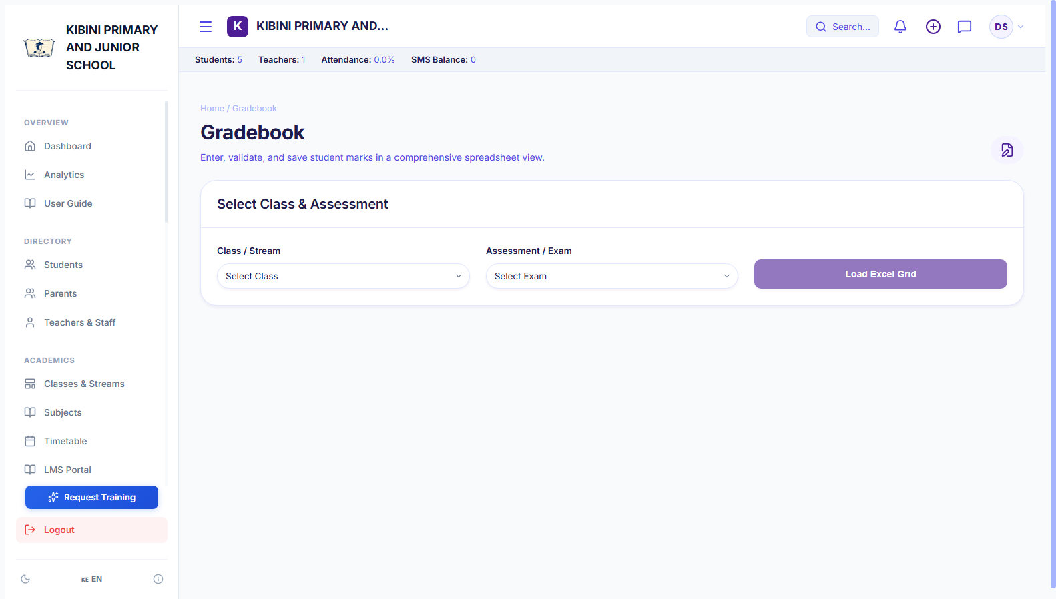
MARKS ENTRY & GRADING
Teacher Gradebook & Fast Marks Entry
Spreadsheet-like tabular scoresheets for quick, error-free student marks entry.
Keyboard-Friendly Grid
Subject teachers enter scores rapidly row-by-row with instant auto-save and tab-key navigation.
🔒 https://somesha.cloud/dashboard/gradebook
● Live School View
Automatic Validation Safeguards
Rejects invalid scores exceeding 100% or negative numbers, highlighting entry typos before saving.
Instant Competency Translation
Automatically converts numerical percentages into CBC competency labels: EE (80-100%), ME (60-79%), AE (40-59%), BE (0-39%).
📋 Step-by-Step School Workflow:
1. Subject teacher selects Exam, Class, and Subject.
2. Enter marks in the clean tabular scoresheet—grades and competencies calculate dynamically.
3. Click 'Submit Scores' to lock grades for headteacher review.
🎯 Value for School Headteachers & BOM
Reduces teacher marks entry time from days to minutes and eliminates mathematical errors in student totals.
Somesha School Portal • Role-Based Access • Encrypted Live Sync

Slide 12
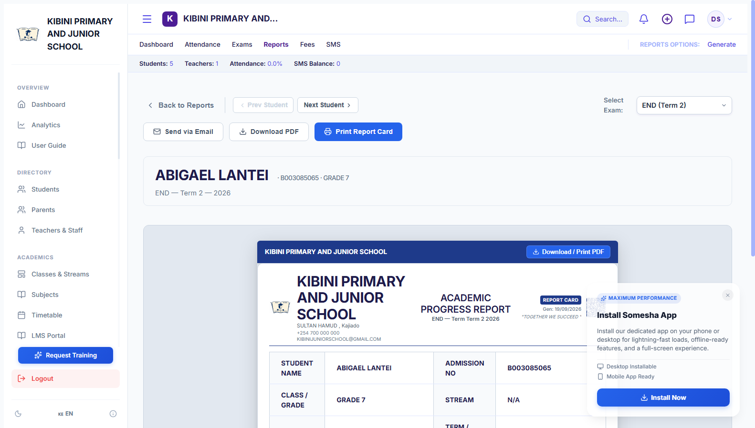
REPORTING ENGINE
CBC Academic Progress Reports & 1-Click PDF
Official, beautifully formatted report cards ready for end-of-term parent meetings.
Full School Header Auto-Fitting
Features dynamic header scaling so long school names (e.g. Kibini Primary & Junior Secondary School) fit cleanly without truncation.
🔒 https://somesha.cloud/dashboard/reports
● Live School View
Comprehensive Performance Tables
Displays Current Score, Previous Term Comparison, Points, CBC Competency, Class Average, and Teacher Remarks.
1-Click PDF Download & Batch Print
Download individual student report cards or generate a single batch PDF for an entire class ready for printing.
📋 Step-by-Step School Workflow:
1. Navigate to 'Reports' and select the desired class and exam period.
2. Preview individual report cards with auto-calculated student ranking and remarks.
3. Click 'Download Report Card PDF' or 'Print Batch' for immediate parent distribution.
🎯 Value for School Headteachers & BOM
Transforms the tedious 2-week end-of-term report preparation into a 1-hour breeze with dignified, error-free results.
Somesha School Portal • Role-Based Access • Encrypted Live Sync

Slide 13
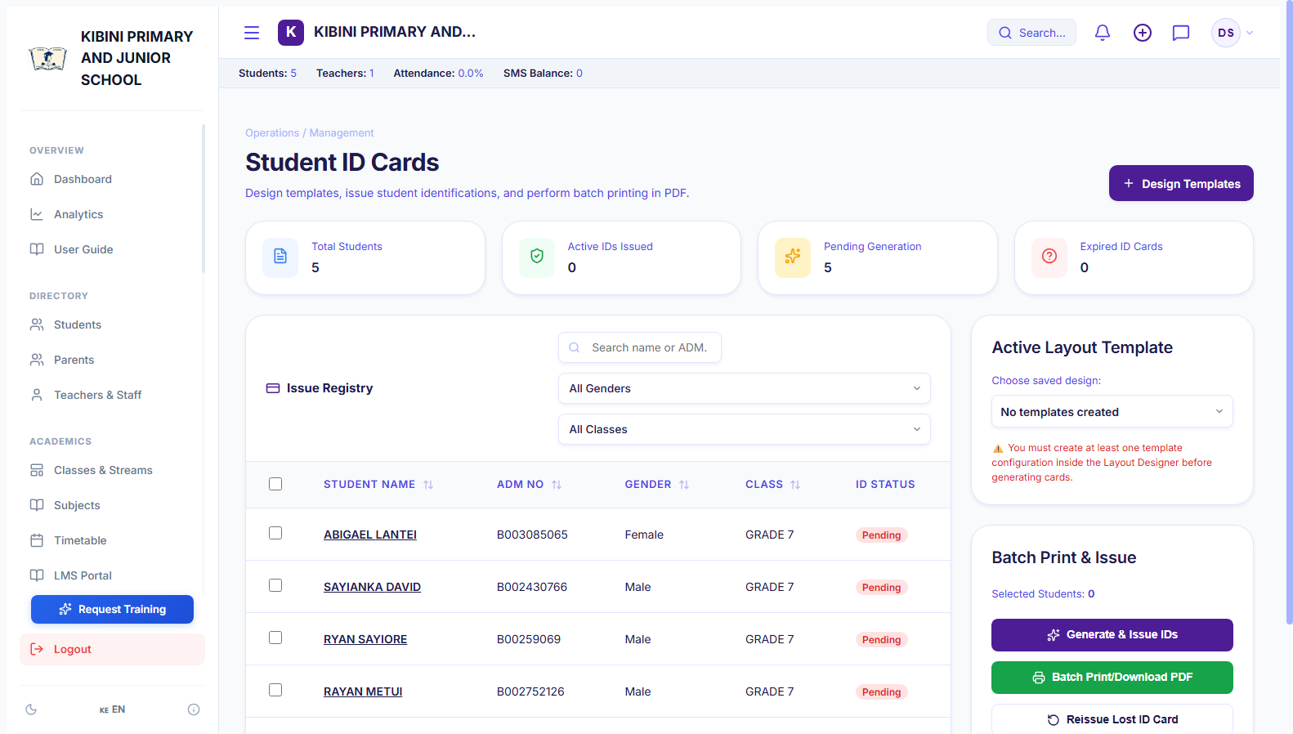
STUDENT SERVICES
Student ID Card Designer & Printable Badges
Generate professional plastic or laminated student identity cards in minutes.
Automated Student Data Merging
Automatically pulls student passport photo, full name, admission number, CBC grade, and parent contact onto the card.
🔒 https://somesha.cloud/dashboard/student-ids
● Live School View
Scannable Barcodes & QR Codes
Embeds unique student identification codes for fast library checkout, cafeteria access, and gate attendance.
Standard Badge Layouts
Formats 8 or 10 ID cards per A4 sheet, perfectly sized for standard PVC badge laminating pouches.
📋 Step-by-Step School Workflow:
1. Open 'Student IDs' and filter by class cohort or individual admission number.
2. Preview the front and back layout of the generated identity card.
3. Click 'Print ID Sheet' to output high-resolution print-ready cards on color printer.
🎯 Value for School Headteachers & BOM
Saves schools thousands of shillings in third-party printing costs while ensuring every learner carries an official school ID.
Somesha School Portal • Role-Based Access • Encrypted Live Sync

Slide 14
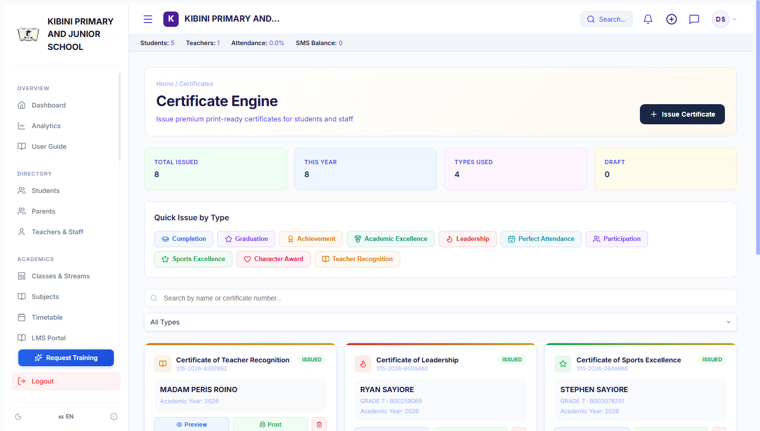
INSTITUTIONAL RECORDS
Official Leaving Certificates & Awards
Generate tamper-proof completion certificates and character testimonials.
Primary & JSS Leaving Certificates
Customized certificate templates for Grade 6 KPSEA completion and Grade 9 Junior Secondary graduation.
🔒 https://somesha.cloud/dashboard/certificates
● Live School View
Conduct & Character Remarks
Record headteacher recommendations, co-curricular achievements, leadership roles (e.g. Head Prefect), and moral standing.
Official Security Border & Signatures
Includes school crest, formal parchment border, principal signature line, and official date stamp.
📋 Step-by-Step School Workflow:
1. Select 'Certificates' > 'Issue Leaving Certificate'.
2. Choose graduating student and enter co-curricular activities and character remarks.
3. Click 'Generate Certificate' to produce an official high-resolution document ready for signing.
🎯 Value for School Headteachers & BOM
Provides graduating students with prestigious, professional credentials for high school and college admissions.
Somesha School Portal • Role-Based Access • Encrypted Live Sync

Slide 15
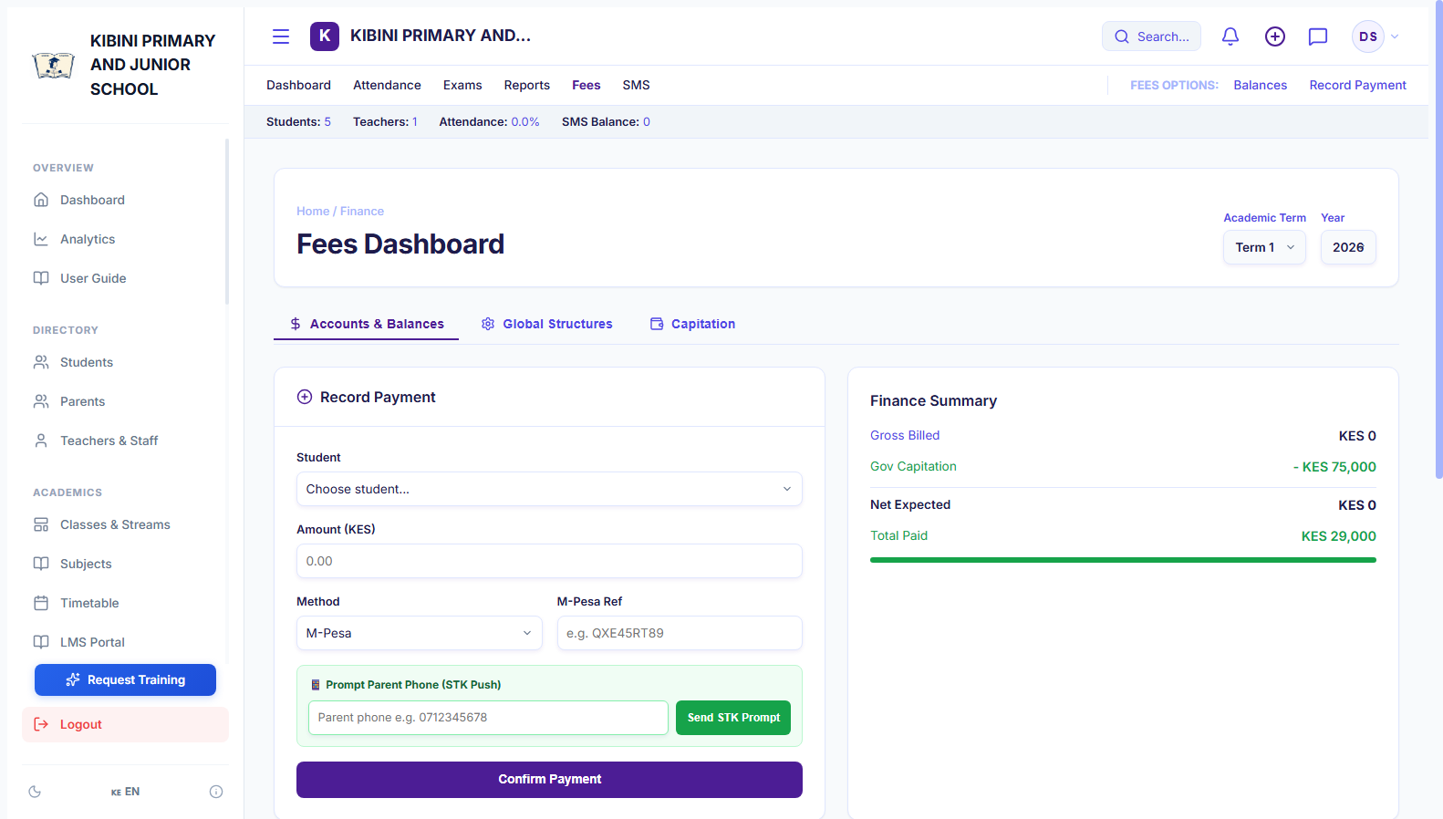
SCHOOL FINANCE
Dynamic Fee Invoicing & Balance Ledgers
Eliminate tuition fee leakages with transparent, automated student accounting.
Custom Class Fee Structures
Configure specific fee line items per grade (e.g. Tuition, Boarding, Lunch, Activity, Examination fees).
🔒 https://somesha.cloud/dashboard/fees
● Live School View
Automated Term Invoicing
Apply term fee structures to all students in a class with one click, generating individual balance ledgers.
Clear Ledger Auditing
Tracks every payment, discount/scholarship, and balance carry-forward with complete transaction histories.
📋 Step-by-Step School Workflow:
1. Bursar creates term fee structure under 'Finance' > 'Fee Structures'.
2. Click 'Apply to Cohort' to generate student invoices for the new academic term.
3. Filter the fee roster to identify students with outstanding balances instantly.
🎯 Value for School Headteachers & BOM
Provides total financial accountability to the Board of Management and eliminates disputed cash or handwritten receipt books.
Somesha School Portal • Role-Based Access • Encrypted Live Sync

Slide 16
FINTECH INTEGRATION
Instant Parent M-Pesa STK Push Collection
Collect school fees directly into your school account via Safaricom Daraja M-Pesa.
1-Click 'Prompt Parent Phone'
Bursars can trigger an instant Safaricom M-Pesa PIN prompt directly on a parent's phone for immediate fee settlement.
🔒 https://somesha.cloud/dashboard/fees
● Live School View
Direct Paybill & Till Support
Supports direct parent payments via School Paybill (e.g. 4007897) or Buy Goods Till, using Admission No as account reference.
Instant Automated Receipts
System automatically updates the student's fee balance the second Safaricom confirms payment, sending an SMS receipt.
📋 Step-by-Step School Workflow:
1. Bursar views student balance and clicks 'Prompt Parent Phone (STK Push)'.
2. Parent receives an instant popup on their phone: 'Do you want to pay KES 5,000 to School? Enter PIN'.
3. Upon PIN entry, payment clears immediately and the student ledger updates to PAID.
🎯 Value for School Headteachers & BOM
Reduces school fee default rates by over 60% and eliminates fraudulent or forged bank deposit slips.
Somesha School Portal • Role-Based Access • Encrypted Live Sync

Slide 17
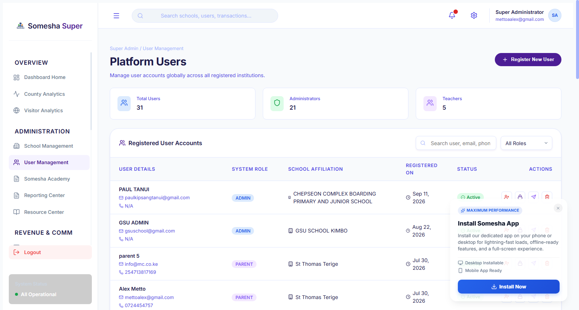
STAFF ADMINISTRATION
Teacher & Staff Account Governance
Manage educator accounts, role permissions, and staffroom collaboration.
Dedicated Teacher Logins
Each teacher receives their own private login credentials with access restricted only to their assigned classes and subjects.
🔒 https://somesha.cloud/dashboard/users
● Live School View
Administrative Role Segregation
Ensure bursars only see finance, teachers only see marks and attendance, while the headteacher retains full oversight.
Staff Directory & Credentials
Easily reset passwords, send SMS login details, and manage staff contact numbers from a central console.
📋 Step-by-Step School Workflow:
1. Go to 'Staff' > '+ Add Staff Member' and enter teacher name, phone, and email.
2. Assign their role (Teacher, Headteacher, Bursar) and link their designated classes.
3. The teacher can log in immediately from their personal phone or laptop.
🎯 Value for School Headteachers & BOM
Guarantees strict exam security and financial confidentiality by preventing unauthorized staff access.
Somesha School Portal • Role-Based Access • Encrypted Live Sync

Slide 18
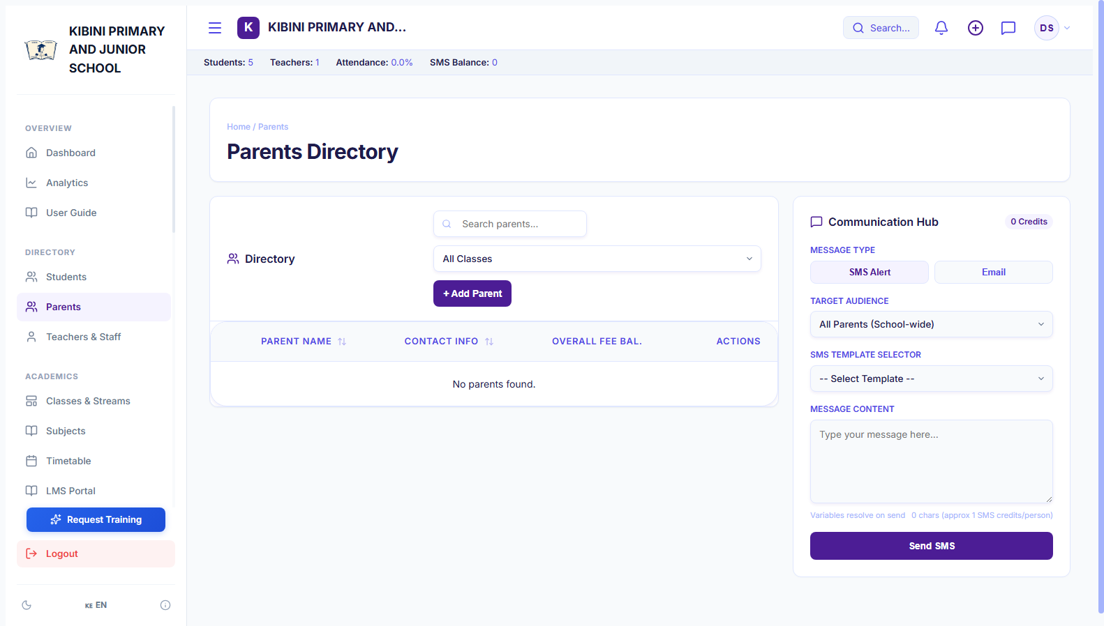
PARENT RELATIONS
Parent Directory & Guardian Communications
Bridge the gap between home and school with unified guardian records.
Linked Guardian Profiles
View parent primary phone, secondary contact, email, and home location linked to all their enrolled children.
🔒 https://somesha.cloud/dashboard/parents
● Live School View
Automated Absence & Fee Alerts
Send automated notifications to parents when a child is marked absent or when fee balances are due.
Parent Portal Access
Parents can log in to view their children's report cards, attendance records, and fee payment receipts from home.
📋 Step-by-Step School Workflow:
1. Open 'Parents' to view the school's complete guardian directory.
2. Search by parent name or student admission number to find direct contact details.
3. Click 'Call' or 'SMS' to initiate immediate communication regarding learner welfare.
🎯 Value for School Headteachers & BOM
Builds parental trust, enhances community engagement, and fosters collaborative student academic growth.
Somesha School Portal • Role-Based Access • Encrypted Live Sync

Slide 19
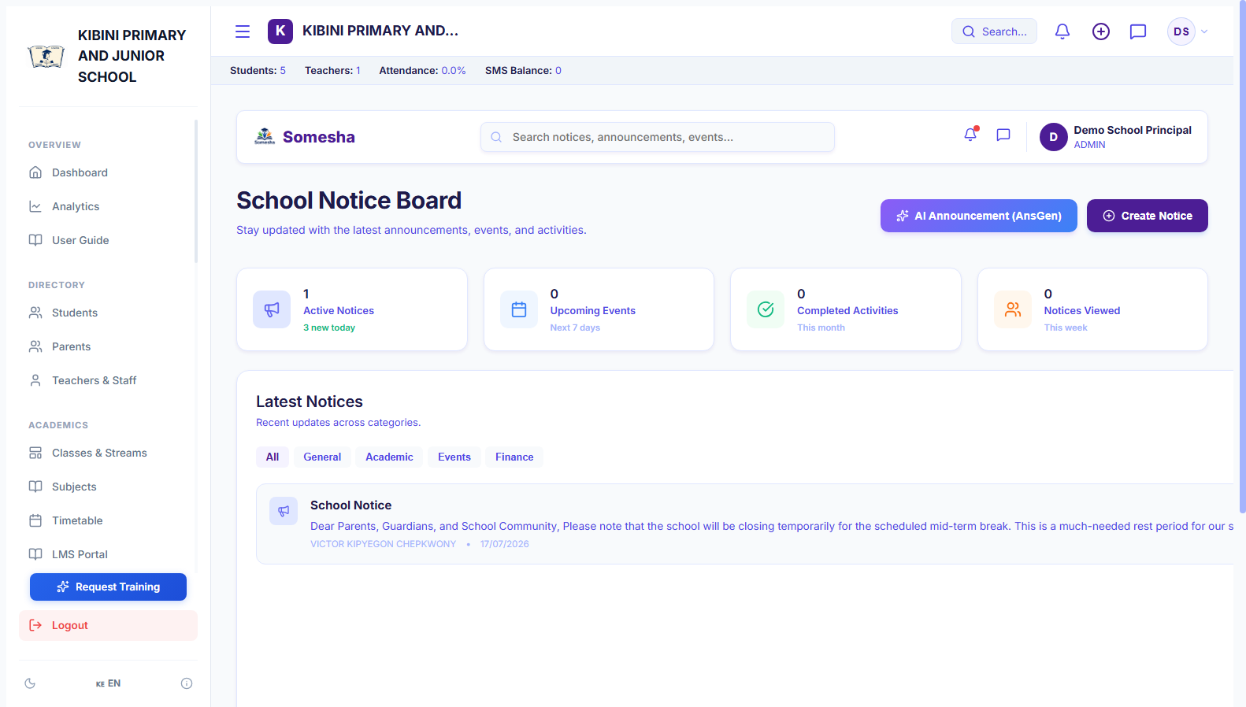
SCHOOL COMMUNICATIONS
Digital Noticeboard & AI Circular Writer
Publish beautiful school announcements without printing a single sheet of paper.
Targeted Audience Dispatch
Publish notices visible to All School, Teaching Staff Only, or Parents of specific grades.
🔒 https://somesha.cloud/dashboard/noticeboard
● Live School View
AI Notice Composer
Built-in intelligent writing assistant formats polite, professional term circulars, sports day notices, and holiday letters in 5 seconds.
Permanent Digital Archive
Past circulars remain permanently accessible on parents' mobile portals, ending lost paper notices in schoolbags.
📋 Step-by-Step School Workflow:
1. Click 'Noticeboard' > '+ New Notice' and enter announcement title.
2. Use the AI Writer or type your circular details, selecting targeted audience.
3. Click 'Publish Notice'—announcement broadcasts immediately to staff and parents.
🎯 Value for School Headteachers & BOM
Slashes paper printing budgets to KES 0 and guarantees 100% receipt of critical notices by parents.
Somesha School Portal • Role-Based Access • Encrypted Live Sync

Slide 20
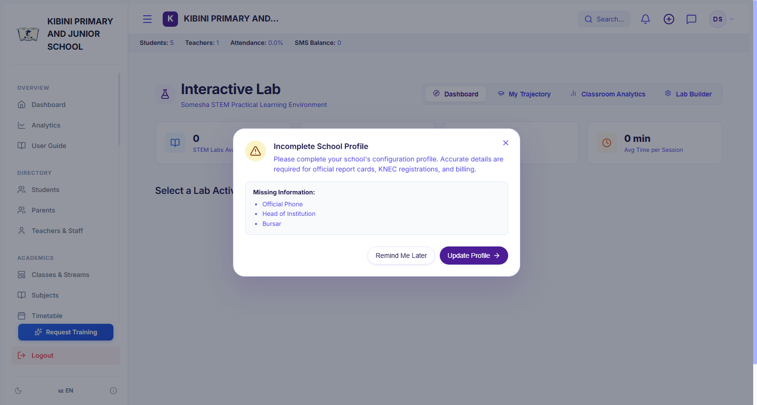
STEM & PRACTICAL SCIENCE
STEM Virtual Simulation Lab & Science Workbench
Conduct practical physics and science experiments on any computer or tablet.
Interactive Circuit Simulation
Virtual electronics workbench featuring Ohm's Law with batteries, switches, resistors, and real-time glowing bulbs.
🔒 https://somesha.cloud/dashboard/lab
● Live School View
Empirical Measurement Plotter
Students adjust voltage and resistance to observe live mathematical relationships and plot V-I scatter curves.
Socratic AI STEM Guide
Contextual AI assistant that provides step-by-step guidance and conceptual hints without giving away assignment answers.
📋 Step-by-Step School Workflow:
1. Teacher or student opens 'STEM Lab' during science or physics lessons.
2. Select experiment (e.g. Ohm's Law) and toggle switches, adjust voltage sliders, and record trials.
3. Consult the embedded AI STEM Guide for guided Socratic questions and explanations.
🎯 Value for School Headteachers & BOM
Equips every school with a world-class science laboratory without requiring millions in expensive physical lab apparatus.
Somesha School Portal • Role-Based Access • Encrypted Live Sync

Slide 21
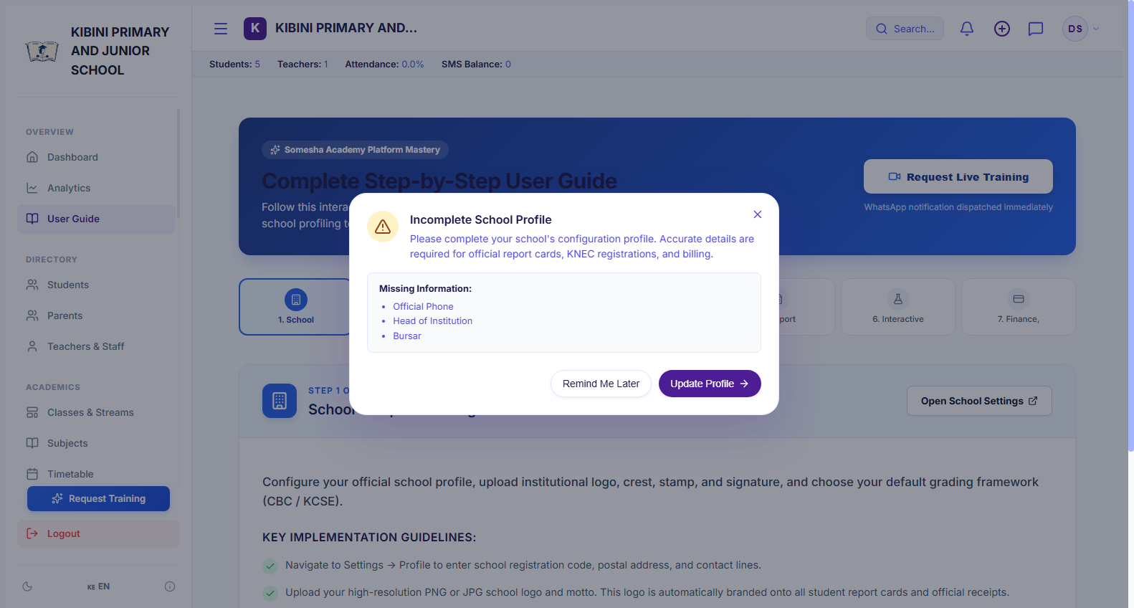
STAFF ONBOARDING
Interactive In-App User Guide & Tutorials
Self-paced visual guidance built directly into the school portal.
Visual Step-by-Step Walkthrough
7 clear operational modules guiding staff through Setup, Academics, Grading, LMS, and Finance.
🔒 https://somesha.cloud/dashboard/guide
● Live School View
Progress Stepper & Checklists
Helps new teachers and bursars track what administrative steps remain to be completed.
Zero Training Downtime
New teachers master the system independently within 30 minutes without requiring external consultants.
📋 Step-by-Step School Workflow:
1. Click 'User Guide' on the main sidebar navigation menu.
2. Navigate through the interactive slide presentation covering each system module.
3. Follow the actionable checklists to set up school records step-by-step.
🎯 Value for School Headteachers & BOM
Eliminates staff training anxiety and enables seamless onboarding whenever new teachers join the school.
Somesha School Portal • Role-Based Access • Encrypted Live Sync

Slide 22
CONTINUOUS SUPPORT
1-Click WhatsApp Training & Personal Support
Direct access to technical education specialists whenever you need guidance.
1-Click 'Request Training' Button
Built into both the sidebar and user guide, allowing headteachers to schedule personalized staff training sessions.
🔒 https://somesha.cloud/dashboard/guide
● Live School View
Instant WhatsApp Dispatch
Automatically generates a prefilled WhatsApp booking dispatched directly to the support phone (+254 724 454 757).
Dedicated Technical Support
Ongoing technical guidance for bulk student imports, Safaricom Daraja setup, and custom report card formatting.
📋 Step-by-Step School Workflow:
1. Click 'Request Training' from the sidebar or user guide.
2. Select preferred training topics (e.g. CBC Grading, Fees & M-Pesa, Bulk Import).
3. Click 'Submit & Open WhatsApp' to connect directly with the Somesha support engineer.
🎯 Value for School Headteachers & BOM
Gives school leaders complete peace of mind with continuous personal support just one WhatsApp message away.
Somesha School Portal • Role-Based Access • Encrypted Live Sync

Slide 23
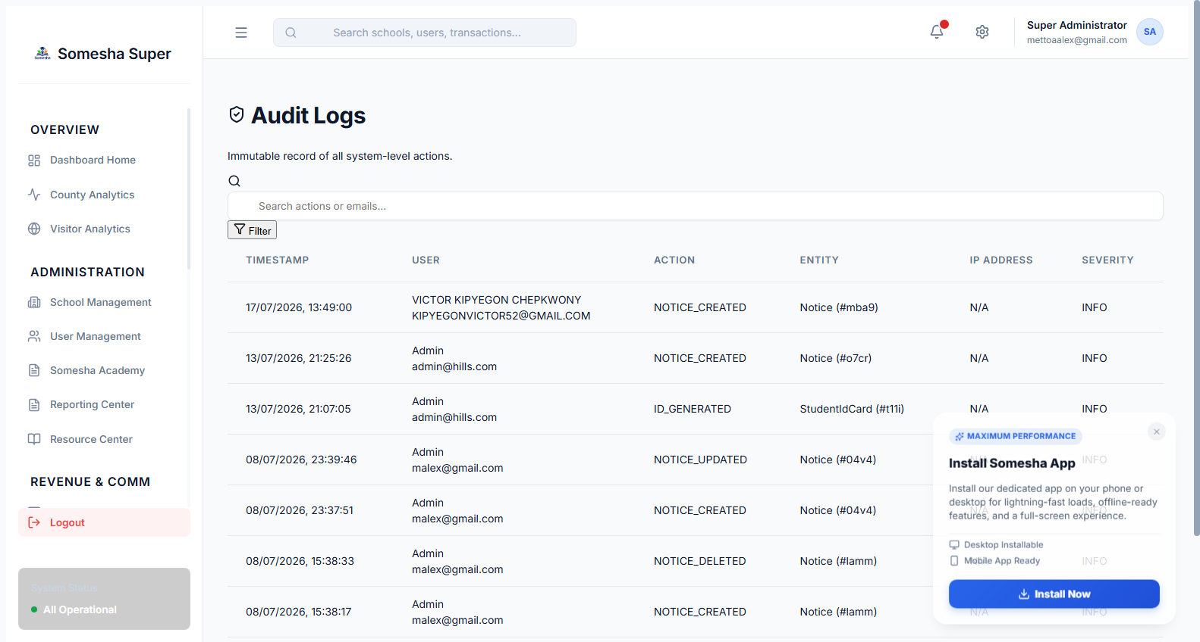
SECURITY & COMPLIANCE
School Data Security & Privacy Protection
Enterprise protection ensuring student records and finances remain 100% confidential.
Kenya Data Protection Act Compliance
Full compliance with Kenyan privacy laws—student and guardian information is never shared or sold.
🔒 https://somesha.cloud/dashboard/settings
● Live School View
Encrypted Cloud Relational Engine
Multi-tenant PostgreSQL database with encrypted password hashing (bcrypt) and secure SSL/TLS transmission.
Daily Automated Backups
Automatic cloud database snapshots prevent any risk of data loss due to hardware failures or accidental deletion.
📋 Step-by-Step School Workflow:
1. All data is automatically encrypted and partitioned specifically to your school tenant.
2. Staff logins are restricted by role—teachers cannot alter financial records.
3. Automated system backups run continuously in the background with zero manual effort required.
🎯 Value for School Headteachers & BOM
Guarantees complete legal compliance and safeguards your institution against cyber risks and data loss.
Somesha School Portal • Role-Based Access • Encrypted Live Sync

Slide 24
7-DAY SCHOOL IMPLEMENTATION BLUEPRINT
7-Day Fast-Track Transition: From Paper & Excel to Somesha
A step-by-step practical adoption pathway designed to transition your school effortlessly without interrupting classes.
Day 1 - 2: Setup & SIS
School Identity & Roster Upload
• Enter School Name, Motto, Crest & MOE Code.
• Import Student CSV roster with UPI / NEMIS numbers.
• Assign learners to CBC grades & streams.
Day 3 - 4: Academic Setup
Teachers, Subjects & Timetable
• Create Teacher accounts & assign class teachers.
• Set up CBC learning areas & lesson allocations.
• Test digital morning roll-call attendance register.
Day 5: Finance & M-Pesa
Fee Structures & Parent Link
• Define termly fee items (Tuition, Meals, Boarding).
• Link parent phone numbers for automatic STK push.
• Send welcome circular on Digital Noticeboard.
Day 6 - 7: Full Go-Live
Exams, Gradebook & Report Cards
• Teachers enter formative & summative scores.
• Auto-generate CBC Competency Report Cards in 1 click.
• Book 1-on-1 WhatsApp staff training (+254 724 454 757).
Need Free Onboarding Assistance? Book a Live Staff Induction Session
Direct WhatsApp Support: +254 724 454 757 | School Helpdesk: support@somesha.cloud | https://somesha.cloud

