Slide 1
KENYA NATIONAL CBC EDUCATION ERP
Somesha School Management ERP
Next-Generation Cloud Platform for Kenyan Primary & Junior Secondary Schools
Empowering School Leadership with Free Enterprise Administration, Real-Time Safaricom M-Pesa, and CBC Mastery
25+ Schools Active
Covering Primary & Junior Secondary Institutions Across Kenya
KES 63.3M+ Tracked
Transparent Digital Fee Invoicing & Live Safaricom M-Pesa
100% CBC Aligned
Formative, Summative, Competency Levels & Auto Merit Lists
Presenter: Technical Operations & System Engineering | Official Platform: https://somesha.cloud | Release: 2026 Enterprise Edition

Slide 2
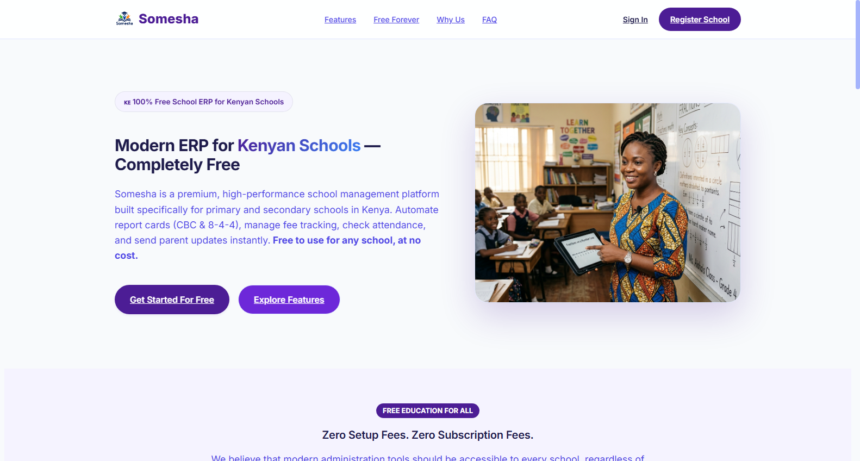
STRATEGIC OVERVIEW
Executive Summary & Educational Vision
Democratizing institutional school administration with modern, cloud-native technology across Kenya's 47 counties.
Zero Licensing Cost Barrier
Built as a mission-driven, free cloud platform eliminating software barriers for primary schools and newly transitioned Junior Secondary Schools (JSS).
🔒 https://somesha.cloud
● Live Production
100% CBC Framework Aligned
Full compliance with Kenya Institute of Curriculum Development (KICD) Competency-Based Curriculum assessment rubrics and performance indicators.
Seamless National FinTech Rails
Native Safaricom Daraja integration providing automated parent STK Push payment prompts, instant Paybill reconciliation, and live fee ledger auditing.
🎯 Strategic Institutional Impact
Enables public and private schools to replace paper registers, eliminate tuition fee leakages, and satisfy Ministry reporting requirements instantly.
Somesha ERP Platform View • Authenticated Institution • High-Speed Cloud Database Sync

Slide 3
SYSTEM ARCHITECTURE & CLOUD ENGINE
Enterprise Cloud Architecture & Multi-Tenancy Engine
High-availability, containerized microservices infrastructure engineered for mission-critical school operations.
Containerized Deployment
Docker & Nginx Reverse Proxy
Application Framework
Next.js 14 & React 18 App Router
Relational Data Layer
PostgreSQL & Prisma ORM
Security & FinTech Rails
Safaricom Daraja & First-Party Telemetry
• Isolated container runtime for zero conflict updates.
• Nginx high-performance reverse proxy with automatic SSL/TLS.
• Sub-100ms API response latency across all 47 counties.
• Automated health checks & zero-downtime rolling deploys.
• Server-Side Rendering (SSR) & optimized client hydration.
• Modular component architecture for instant screen rendering.
• Responsive layout across mobile phones, tablets, and desktops.
• Strict TypeScript typing ensuring zero runtime compilation errors.
• Robust multi-tenant relational schema with foreign key safety.
• High-concurrency connection pooling for peak exam periods.
• SystemSetting database persistence resilient across container builds.
• Automated database snapshots and verifiable migration rollbacks.
• Direct Safaricom Daraja M-Pesa STK Push & C2B Paybill gateway.
• Role-Based Access Control (RBAC) across 6 distinct user tiers.
• 100% first-party visitor telemetry compliant with Data Protection Act.
• Bcrypt salted password encryption and tamper-proof audit trails.

Slide 4
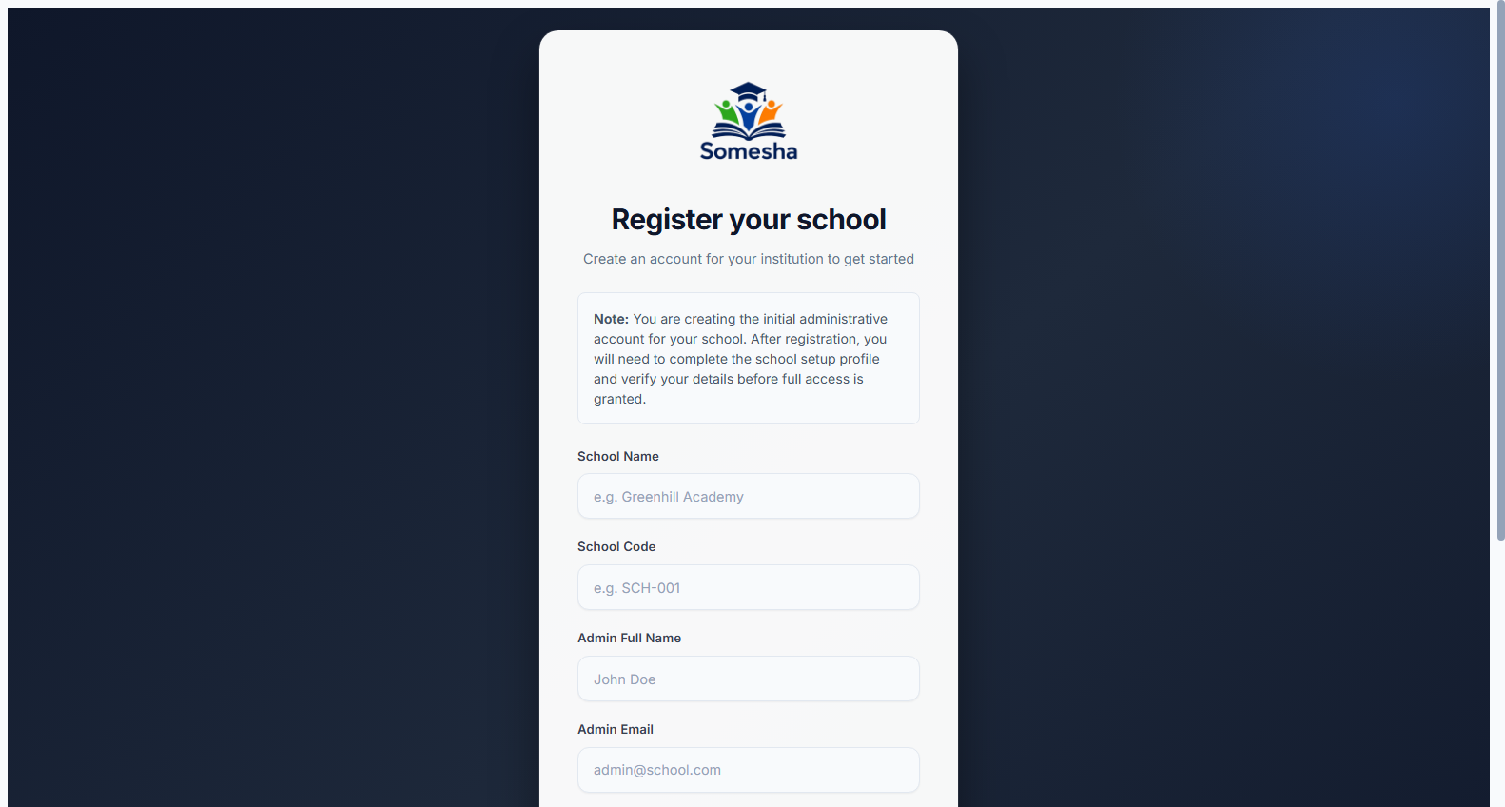
PUBLIC PORTAL & ONBOARDING
School Registration & Instant Provisioning
Self-service institutional onboarding designed for rapid adoption with zero complex installation.
Modern Public Portal
Professional landing page highlighting system features, CBC curriculum alignment, fee automation, and virtual science lab benefits for prospective schools.
🔒 https://somesha.cloud/register
● Live Production
3-Minute Self Registration
School administrators register their institution in minutes, capturing school category, county location, and authorized administrative contact details.
Instant Multi-Tenant Provisioning
Automated database tenant isolation immediately creates school rosters, default fee structures, and administrative roles upon sign-up.
🎯 Strategic Institutional Impact
Removes technical onboarding bottlenecks—headteachers can launch their digital school workspace independently on mobile or PC.
Somesha ERP Platform View • Authenticated Institution • High-Speed Cloud Database Sync

Slide 5
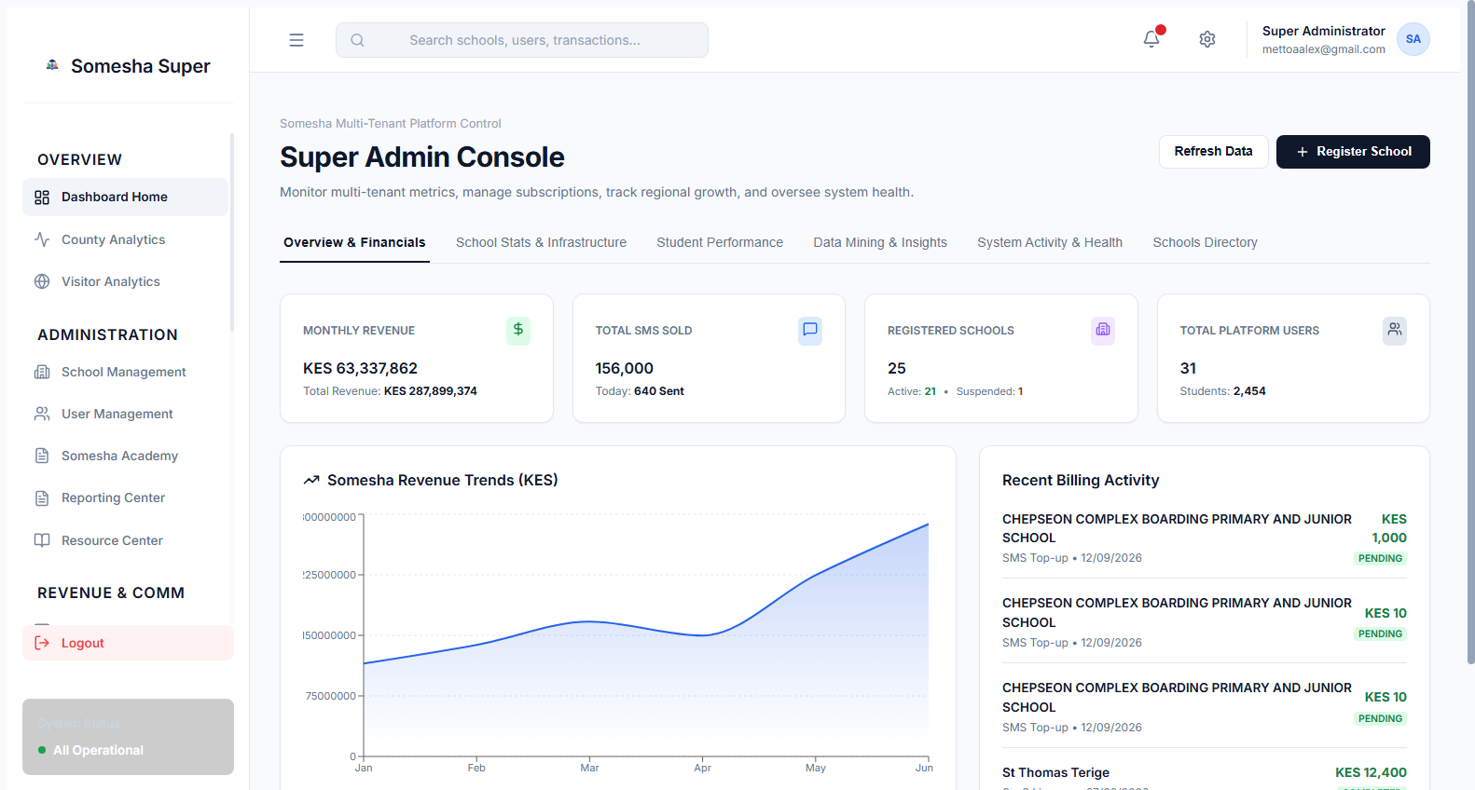
SUPER ADMIN COMMAND CENTER
National Oversight & System Analytics
Executive command console providing high-level governance across all onboarded institutions.
Live Platform Financial KPIs
Tracks nationwide institutional revenue (KES 63.3M+ recorded), system transaction volumes, and registered user growth in real time.
🔒 https://somesha.cloud/super-admin
● Live Production
Institution & User Metrics
Monitors active schools (25+ institutions) and user accounts (31 administrators & teachers) with direct administrative drill-downs.
Interactive Revenue Trends
Visual line and bar charts tracking monthly fee collection trends and system activity cycles across academic terms.
🎯 Strategic Institutional Impact
Provides ministry officials and school network directors with complete, untampered oversight of institutional performance and revenue.
Somesha ERP Platform View • Authenticated Institution • High-Speed Cloud Database Sync

Slide 6
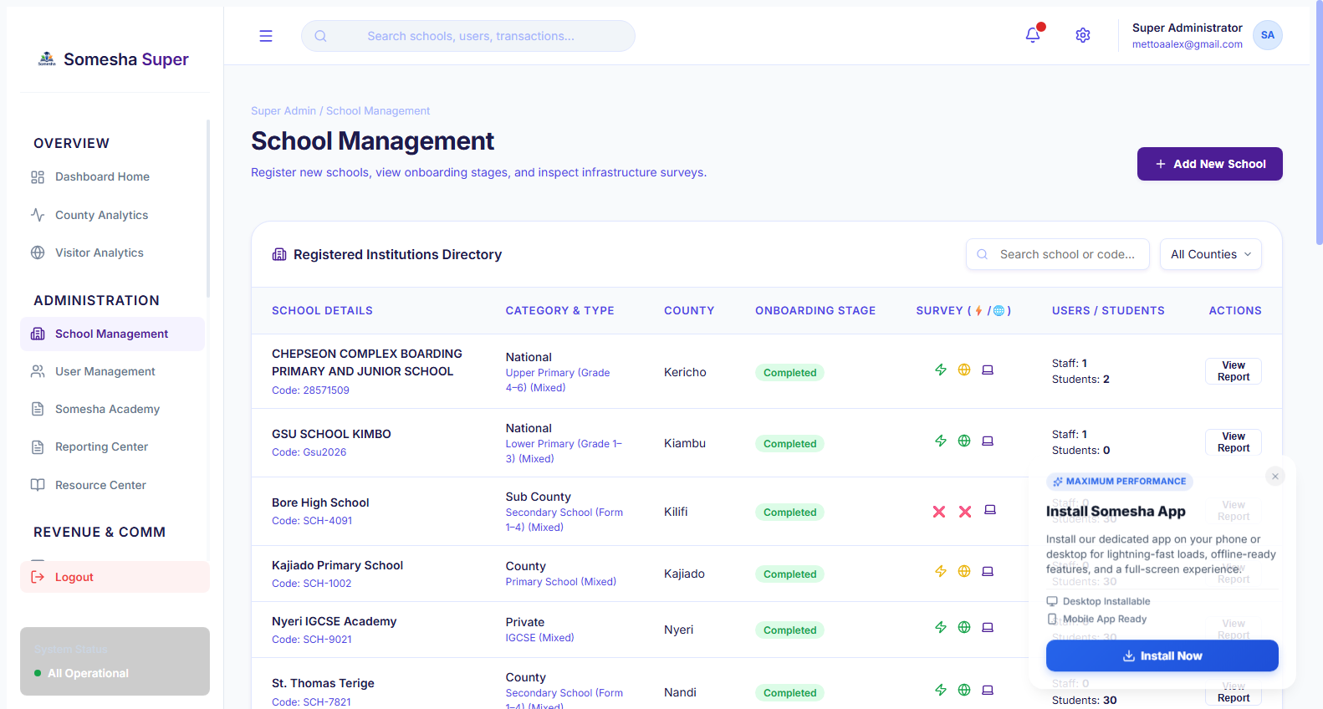
INSTITUTIONAL REGISTRY
Multi-School Governance & County Directory
Centralized registry managing institutions across all 47 counties of Kenya.
Searchable Institutional Registry
Instant search and filter by school name, registration code, or county (e.g. Nakuru, Nairobi, Kericho, Kiambu, Uasin Gishu).
🔒 https://somesha.cloud/super-admin/schools
● Live Production
School Type Categorization
Differentiates between Primary Schools, Junior Secondary Schools (JSS), Day Schools, and Boarding Institutions.
Direct Operational Actions
Super administrators can review school details, assign dedicated support engineers, and inspect institutional enrollment health.
🎯 Strategic Institutional Impact
Eliminates fragmented regional spreadsheets by unifying all school identities under an encrypted, auditable national database.
Somesha ERP Platform View • Authenticated Institution • High-Speed Cloud Database Sync

Slide 7
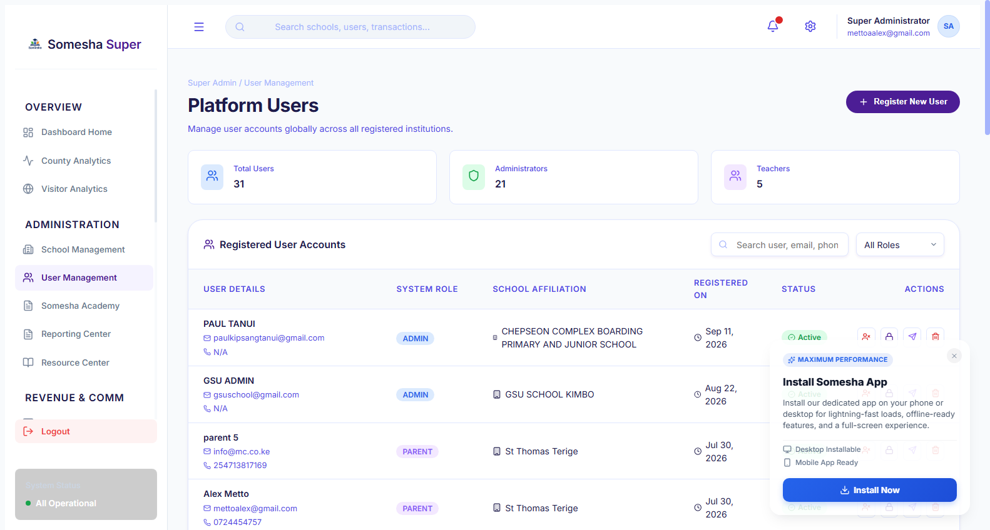
SECURITY & ACCESS CONTROL
Granular User Management & RBAC
Enterprise authentication with zero-trust role segregation across 6 distinct user tiers.
Role-Based Permissions Matrix
Strict policy enforcement separating Super Admin, School Admin (Principal), Teacher, Parent, Student, and Bursar access.
🔒 https://somesha.cloud/super-admin/users
● Live Production
Secure Credential Management
Instant one-click password resets with optional automated SMS / Email notification dispatch to authorized personnel.
Comprehensive Audit Trails
Every security-sensitive action (login attempts, permission changes, roster updates) is permanently logged in `SecurityAuditLog`.
🎯 Strategic Institutional Impact
Guarantees student data privacy and prevents unauthorized financial or academic modifications with military-grade access control.
Somesha ERP Platform View • Authenticated Institution • High-Speed Cloud Database Sync

Slide 8
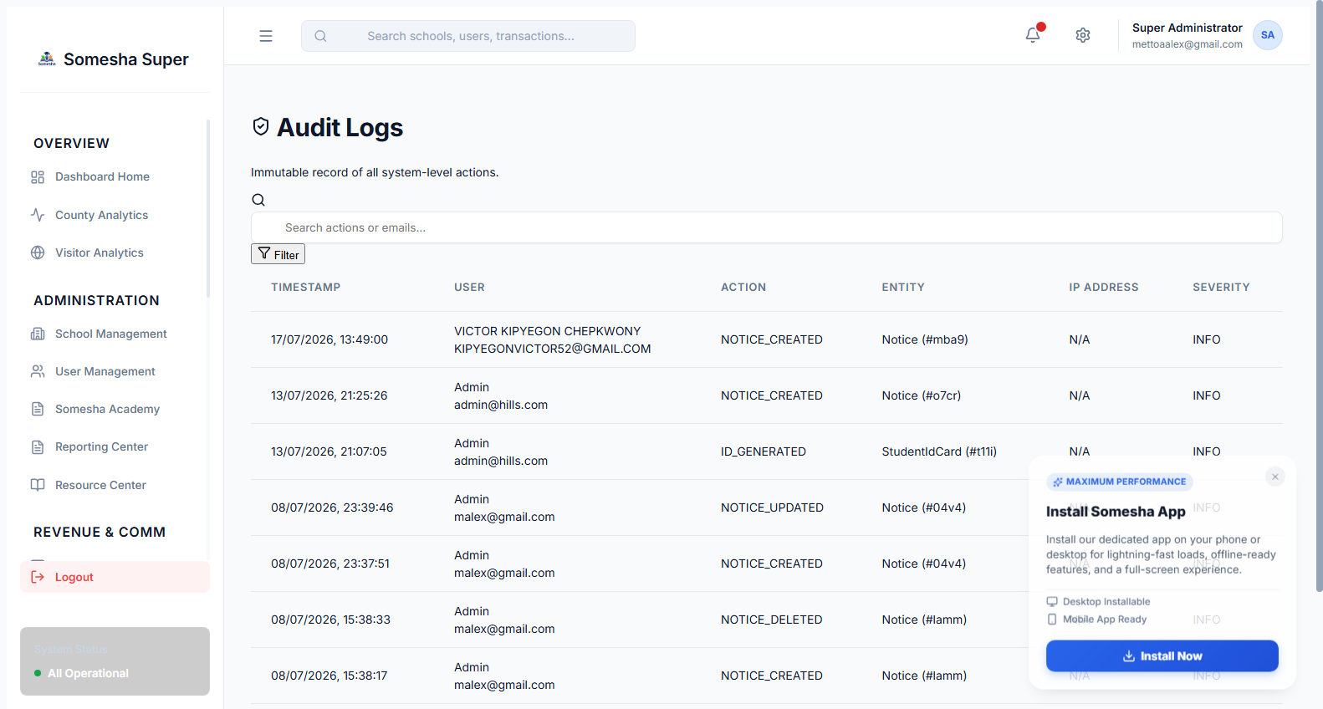
SECURITY & COMPLIANCE
Comprehensive Security Audit Trail
Immutable logging of all administrative actions, logins, and system configuration updates.
Real-Time Event Ingestion
Captures administrative logins, failed authentication attempts, role modifications, and system configuration adjustments instantly.
🔒 https://somesha.cloud/super-admin/security/audit
● Live Production
Granular Audit Metadata
Logs IP addresses, user agent strings, precise timestamps, and before-and-after change diffs in PostgreSQL `SecurityAuditLog`.
Forensic & Compliance Auditing
Ensures strict compliance with the Kenya Data Protection Act 2019 and prevents repudiation of sensitive administrative actions.
🎯 Strategic Institutional Impact
Provides institutional stakeholders with an unalterable security audit trail, guaranteeing total operational accountability.
Somesha ERP Platform View • Authenticated Institution • High-Speed Cloud Database Sync

Slide 9
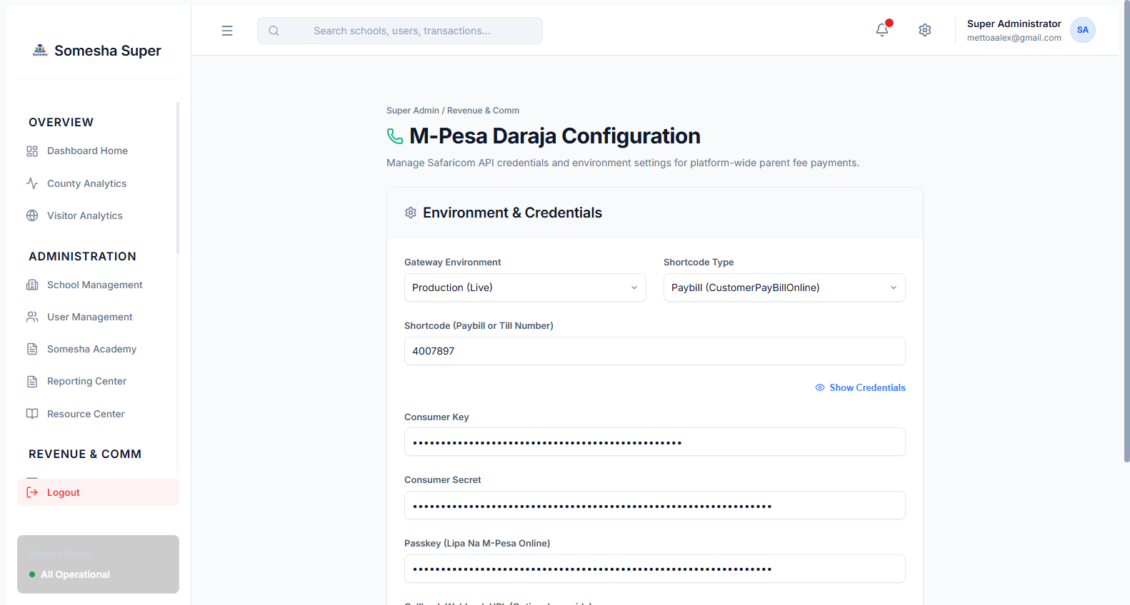
FINTECH INTEGRATION
Safaricom M-Pesa Daraja 2.0 Gateway
Turnkey mobile payment infrastructure powering instant fee payments and SMS top-ups.
Paybill & Till Number Flexibility
Supports both CustomerPayBillOnline (e.g. Paybill 4007897) and CustomerBuyGoodsOnline (Till) configurations.
🔒 https://somesha.cloud/super-admin/revenue/mpesa
● Live Production
Live OAuth Token Generation
Direct integration with Safaricom Daraja API with automated token refresh, validation testing, and detailed diagnostic logs.
Database-Persistent Credentials
Encrypted credentials stored in PostgreSQL `SystemSetting` table, guaranteeing 100% uptime through container rebuilds.
🎯 Strategic Institutional Impact
Unlocks instant, cashless school revenue collection—eliminating fraudulent bank deposit slips and delayed reconciliations.
Somesha ERP Platform View • Authenticated Institution • High-Speed Cloud Database Sync

Slide 10
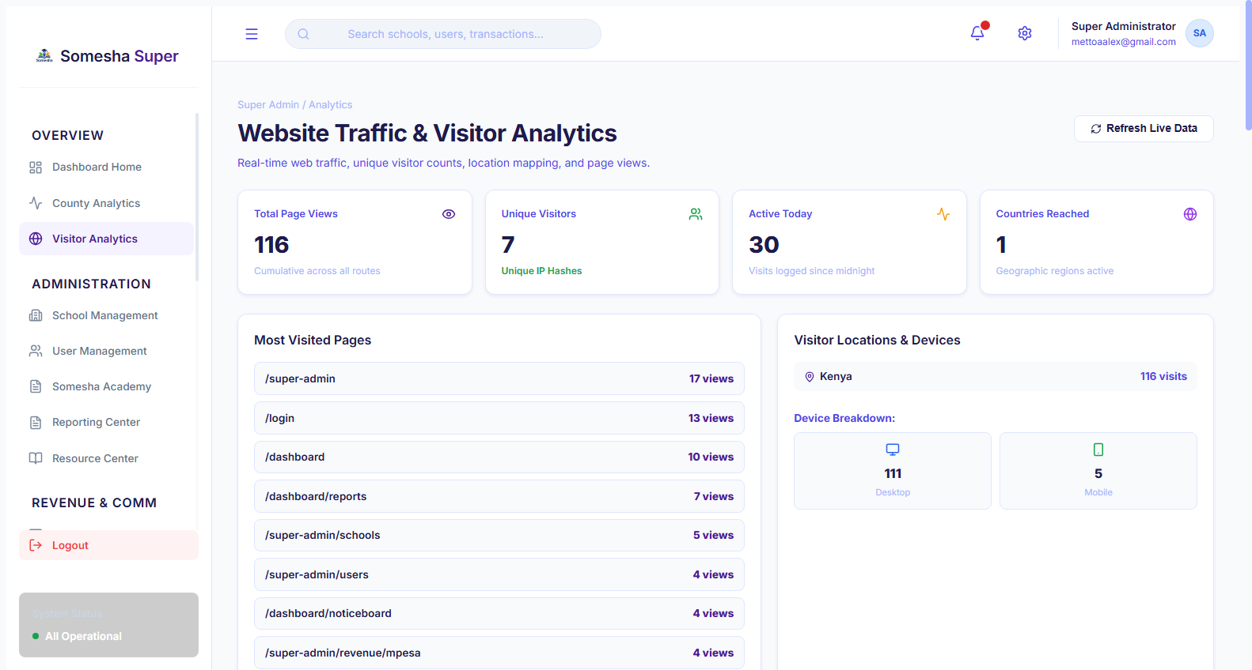
INTELLIGENCE & TELEMETRY
Privacy-Preserving Visitor Analytics
Self-hosted first-party telemetry tracking portal traffic without third-party surveillance scripts.
100% First-Party Data Ownership
Full compliance with Kenya Data Protection Act 2019 without relying on Google Analytics or tracking cookies.
🔒 https://somesha.cloud/super-admin/analytics/visitors
● Live Production
Live Traffic Metrics
Tracks unique visitors, total page hits, bounce rates, and traffic sources across public landing pages and login gateways.
Geographic & Device Intelligence
Reveals visitor devices (Mobile vs Desktop) and geographic cities across Kenya to optimize communication reach.
🎯 Strategic Institutional Impact
Delivers high-level behavioral engagement data to administrators while strictly safeguarding institutional user privacy.
Somesha ERP Platform View • Authenticated Institution • High-Speed Cloud Database Sync

Slide 11
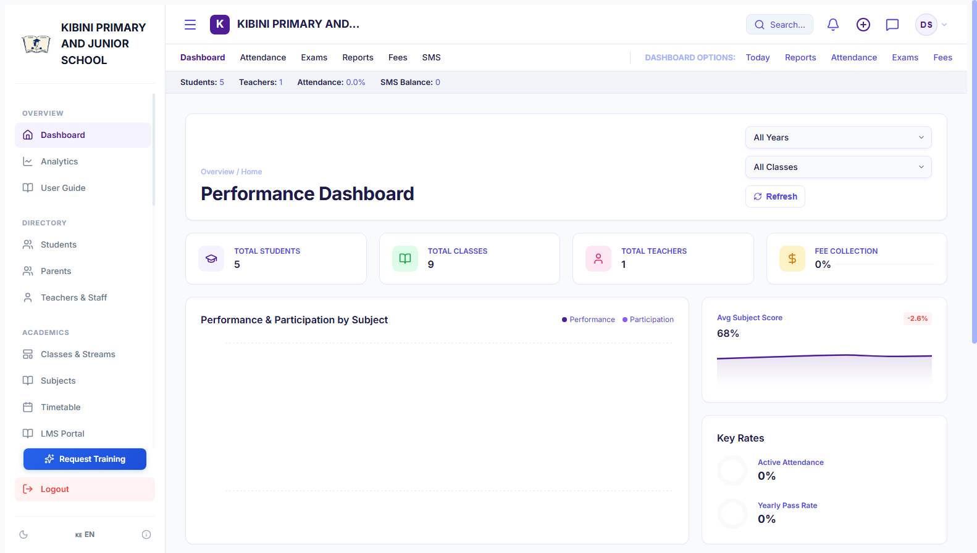
PRINCIPAL OPERATIONS
School Leadership Command Dashboard
Daily operational nerve center providing headteachers with real-time institutional metrics.
Live School Pulse
Displays enrolled student headcount, active classes, term fee collection totals, and pending administrative tasks at a glance.
🔒 https://somesha.cloud/dashboard
● Live Production
Financial Collection Progress
Visual summary of total fees invoiced versus actual M-Pesa collections and outstanding parental balances.
Operational Quick Shortcuts
Single-click navigation to register new students, mark daily attendance, post circulars, or generate end-term report cards.
🎯 Strategic Institutional Impact
Saves school principals over 2 hours every day by consolidating attendance, fees, and academic records into a single clear view.
Somesha ERP Platform View • Authenticated Institution • High-Speed Cloud Database Sync

Slide 12
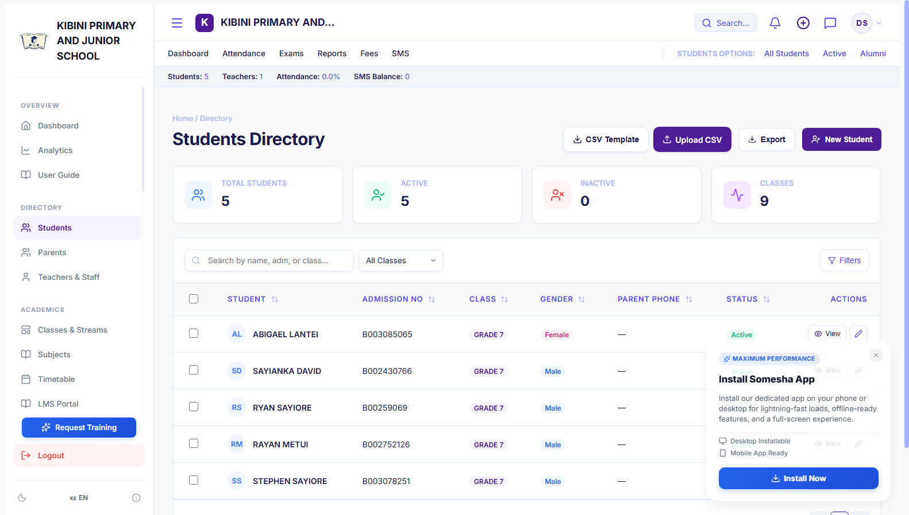
STUDENT INFORMATION SYSTEM
Comprehensive Digital Student Rosters
Centralized student records capturing demographic, academic, and guardian information.
Universal Student Profile
Captures Ministry NEMIS / UPI numbers, admission codes, date of birth, gender, home county, and medical emergency details.
🔒 https://somesha.cloud/dashboard/students
● Live Production
Dynamic Class & Stream Placement
Organizes students by CBC Grade and assigned stream (e.g. Grade 7 East, Grade 8 West) with instant reassignment.
Fast Real-Time Search & Filters
Sub-second filtering by student name, admission number, or grade level, coupled with batch CSV spreadsheet import.
🎯 Strategic Institutional Impact
Replaces lost paper admission books with permanent, tamper-resistant digital records accessible anytime from any device.
Somesha ERP Platform View • Authenticated Institution • High-Speed Cloud Database Sync

Slide 13
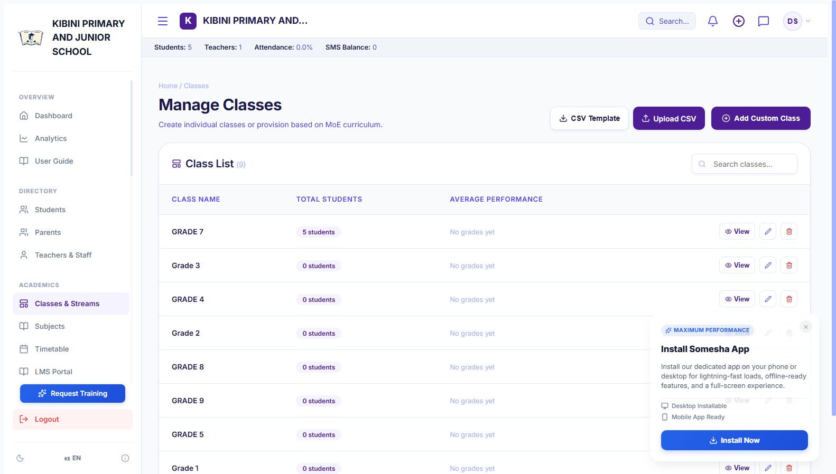
ACADEMIC MANAGEMENT
CBC Curriculum & Stream Architecture
Engineered specifically to support Kenya's 2-6-3-3-3 Competency-Based Curriculum framework.
Multi-Tier Educational Levels
Native support for Pre-Primary (PP1, PP2), Primary (Grades 1-6), and Junior Secondary School (JSS Grades 7-9).
🔒 https://somesha.cloud/dashboard/classes
● Live Production
Stream Distribution & Balancing
Easily manage multiple streams per grade (East, West, North, South) with capacity limits to prevent overcrowding.
Teacher & Subject Allocation
Assign class teachers and link specialized subject tutors to their respective learning areas.
🎯 Strategic Institutional Impact
Ensures flawless class scheduling and accurate student-to-teacher ratios compliant with Ministry of Education standards.
Somesha ERP Platform View • Authenticated Institution • High-Speed Cloud Database Sync

Slide 14
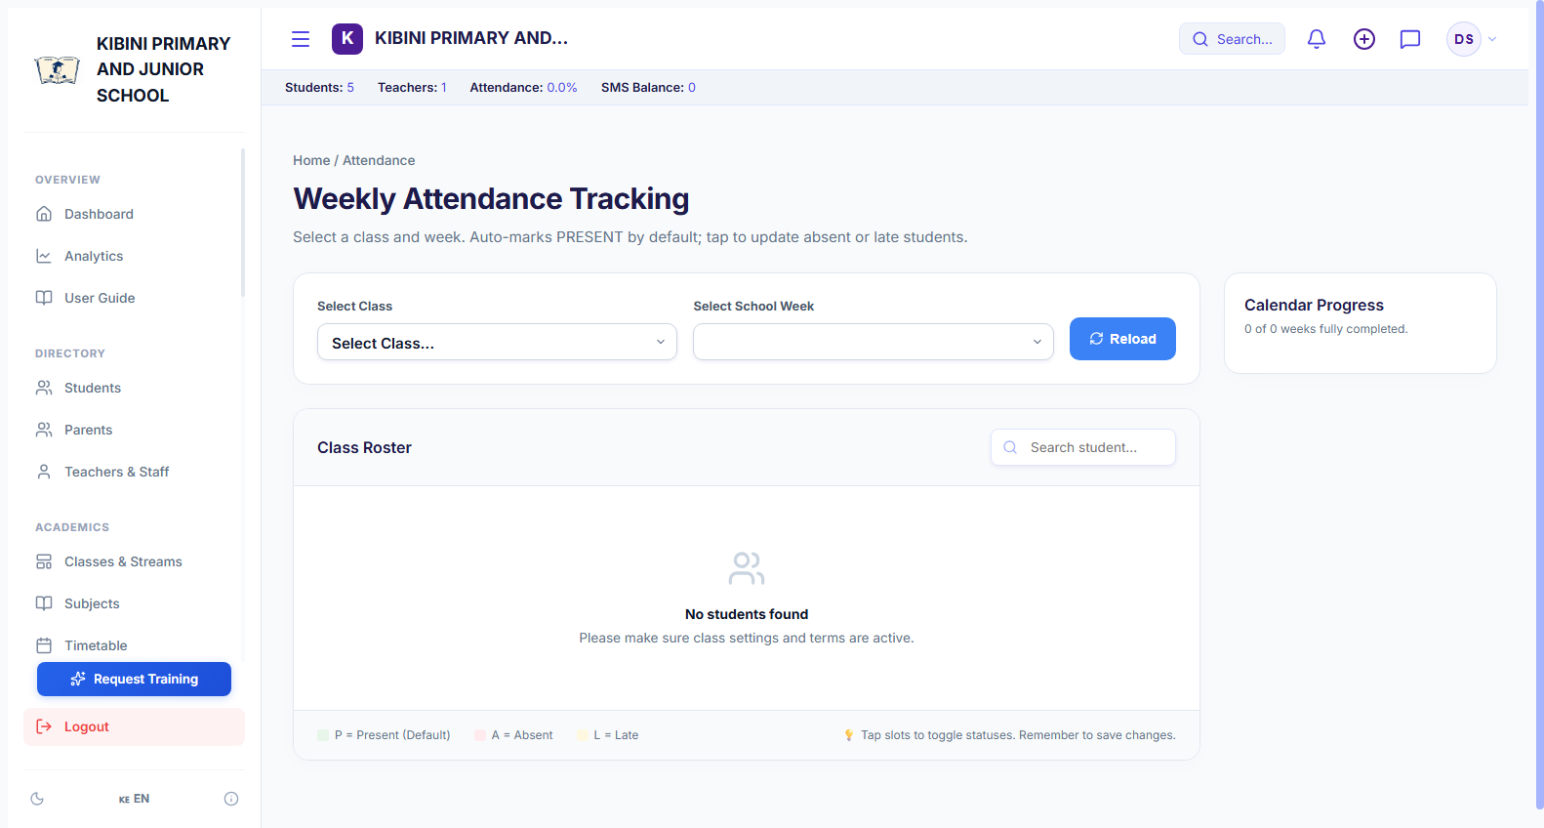
STUDENT WELFARE
Interactive Daily Attendance Tracker
Effortless morning roll-call register with automated absenteeism tracking.
Weekly Roster Register Grid
Intuitive tabular roster allowing teachers to mark Present, Absent, Late, or Excused with a single click or tap on phone/tablet.
🔒 https://somesha.cloud/dashboard/attendance
● Live Production
Attendance Trend Analytics
Computes cumulative percentage attendance rates per student and flags chronic absenteeism patterns automatically.
Parent Notification Ready
Enables rapid identification of unexcused absences, allowing immediate follow-up with guardians.
🎯 Strategic Institutional Impact
Boosts student retention, enhances learner safety, and generates verified attendance audits required by educational inspectors.
Somesha ERP Platform View • Authenticated Institution • High-Speed Cloud Database Sync

Slide 15
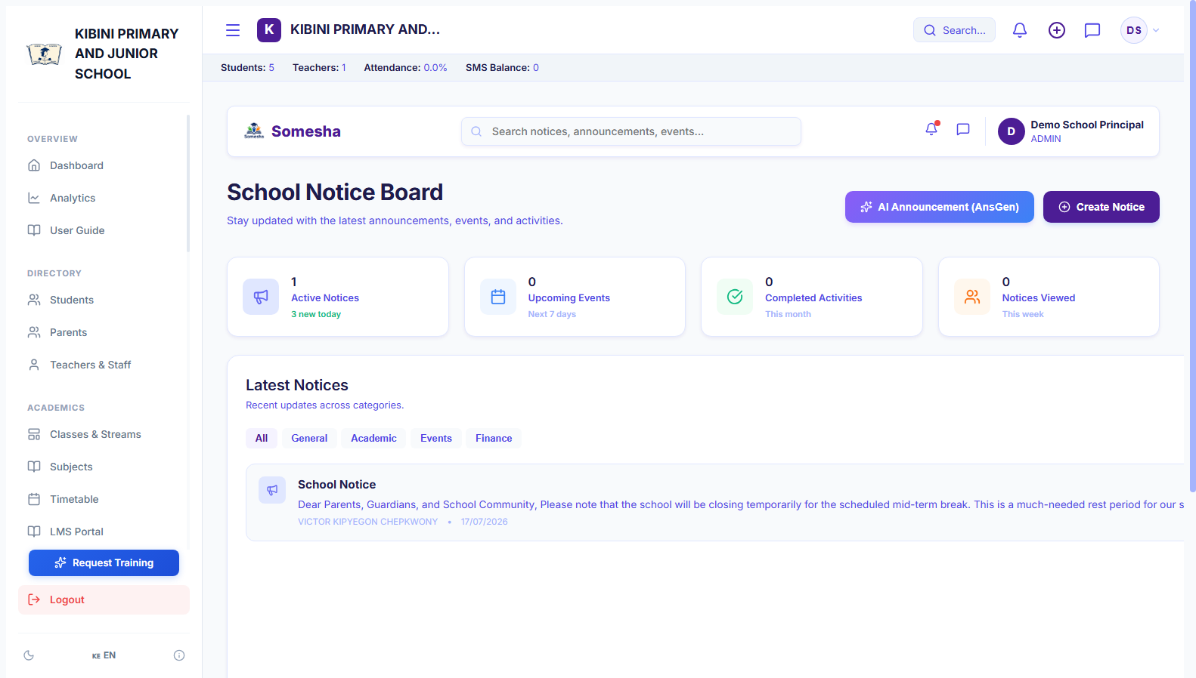
SCHOOL COMMUNICATIONS
Digital Noticeboard & Parent Broadcast Hub
Multi-channel announcement system delivering instant school updates and circulars.
Multi-Audience Targeting
Publish official notices directed to Everyone, Parents Only, Teaching Staff, or Specific Grade levels.
🔒 https://somesha.cloud/dashboard/noticeboard
● Live Production
AI-Assisted Notice Composer
Built-in intelligent writing assistant helps teachers format professional, polite circulars and event announcements in seconds.
Searchable Digital Archive
Parents and staff can review historical circulars, term dates, and sports events anytime without losing printed paper slips.
🎯 Strategic Institutional Impact
Slashes paper printing expenses to KES 0 while ensuring 100% of critical school notices reach parent smartphones instantly.
Somesha ERP Platform View • Authenticated Institution • High-Speed Cloud Database Sync

Slide 16
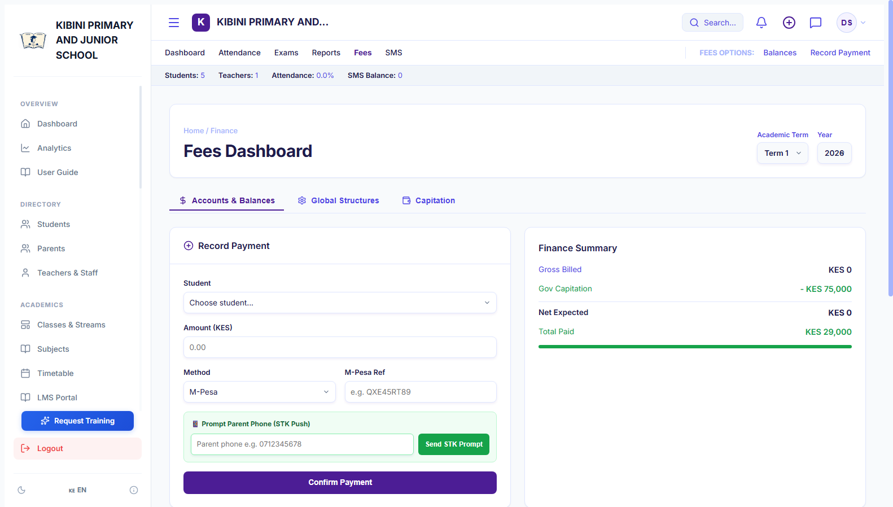
FINANCIAL MANAGEMENT
Fee Invoicing & Real-Time M-Pesa STK Push
Automated billing and mobile checkout that reduces school fee defaults by over 60%.
Structured Termly Invoicing
Generate tuition, activity, and boarding fee structures with automatic balance ledger updates across entire cohorts.
🔒 https://somesha.cloud/dashboard/fees
● Live Production
Instant Parent STK Push Trigger
Bursars can click 'Prompt Parent Phone' to dispatch an instant Safaricom M-Pesa PIN prompt directly to the guardian's handset.
Automatic Payment Reconciliation
Safaricom Daraja callbacks update student balances in real time, issue M-Pesa receipt codes, and eliminate manual receipts.
🎯 Strategic Institutional Impact
Accelerates school cash flow dramatically by making fee payments as simple as entering an M-Pesa PIN on a mobile phone.
Somesha ERP Platform View • Authenticated Institution • High-Speed Cloud Database Sync

Slide 17
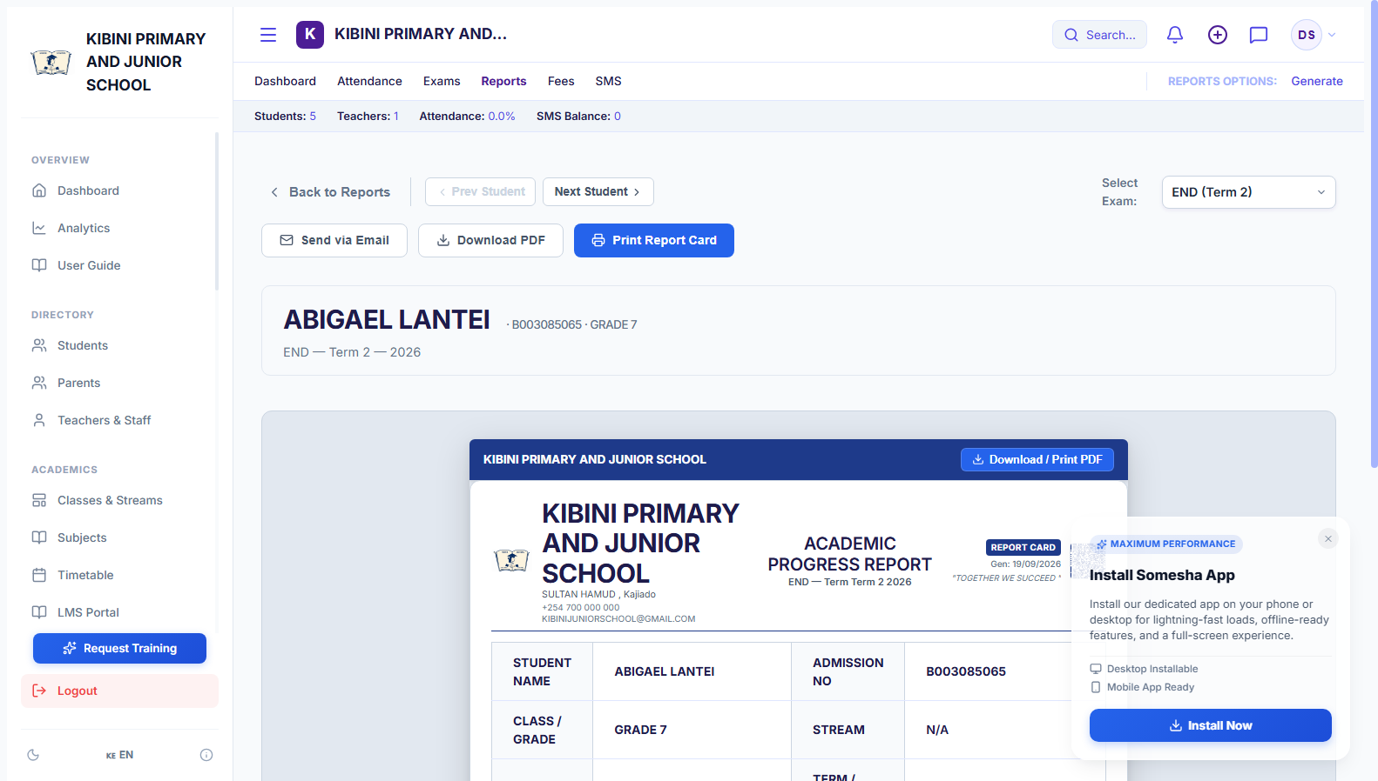
ACADEMIC ASSESSMENT
CBC Academic Progress Reports & PDF Engine
Ministry-compliant formative & summative competency evaluation with 1-click export.
CBC 4-Level Competency Scale
Evaluates learners across: Exceeding Expectations (EE), Meeting Expectations (ME), Approaching (AE), and Below Expectations (BE).
🔒 https://somesha.cloud/dashboard/reports
● Live Production
Subject-by-Subject Analytics
Detailed performance breakdowns including previous term score comparisons, point aggregations, and teacher remarks.
1-Click Official PDF Generation
High-resolution printable PDF export formatted with dynamic school name scaling, official crest, and principal signature lines.
🎯 Strategic Institutional Impact
Cuts end-of-term grading and report preparation time from 2 weeks down to under 1 hour, delivering elegant report cards parents cherish.
Somesha ERP Platform View • Authenticated Institution • High-Speed Cloud Database Sync

Slide 18
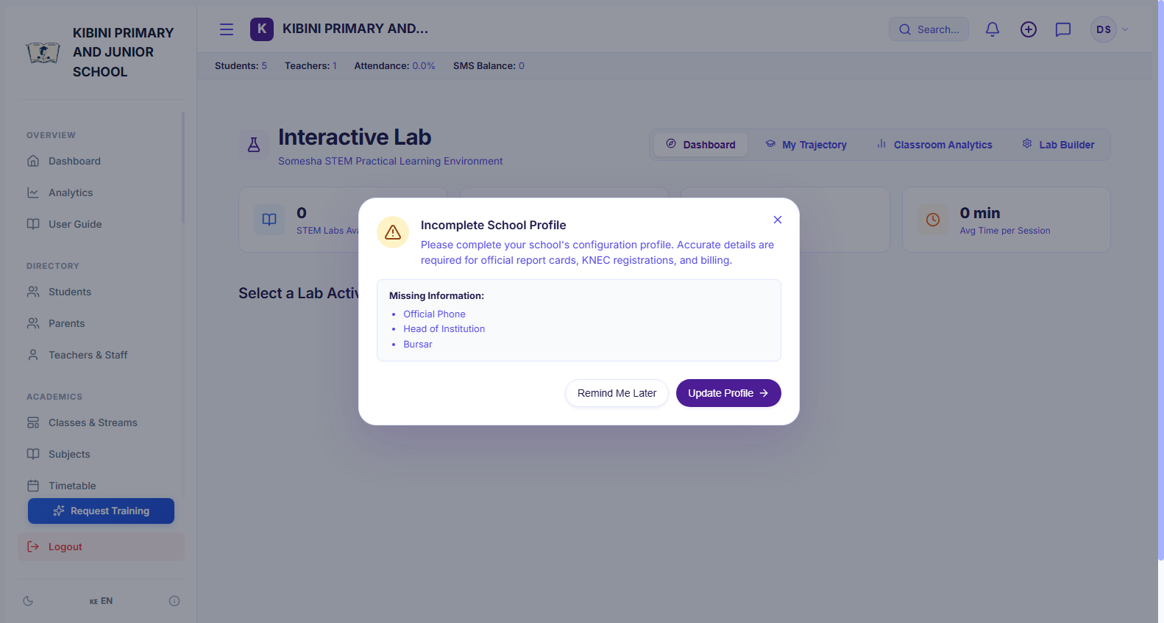
STEM & INNOVATION
STEM Virtual Lab & Interactive Science Workbench
Interactive virtual physics and electronics laboratory bringing science to life without costly equipment.
Dynamic Circuit Simulation
Interactive circuit board featuring Ohm's Law and Newton's Laws with animated current flow, switches, dials, and responsive bulbs.
🔒 https://somesha.cloud/dashboard/lab
● Live Production
Empirical Data Plotter
Students adjust voltage and resistance sliders to observe mathematical relationships, plotting real-time V-I scatter curves.
Socratic AI STEM Guide
Embedded contextual AI tutor that provides step-by-step guidance, hints, and conceptual explanations without giving away answers.
🎯 Strategic Institutional Impact
Empowers under-resourced schools with high-grade practical science experiments on any basic computer or tablet.
Somesha ERP Platform View • Authenticated Institution • High-Speed Cloud Database Sync

Slide 19
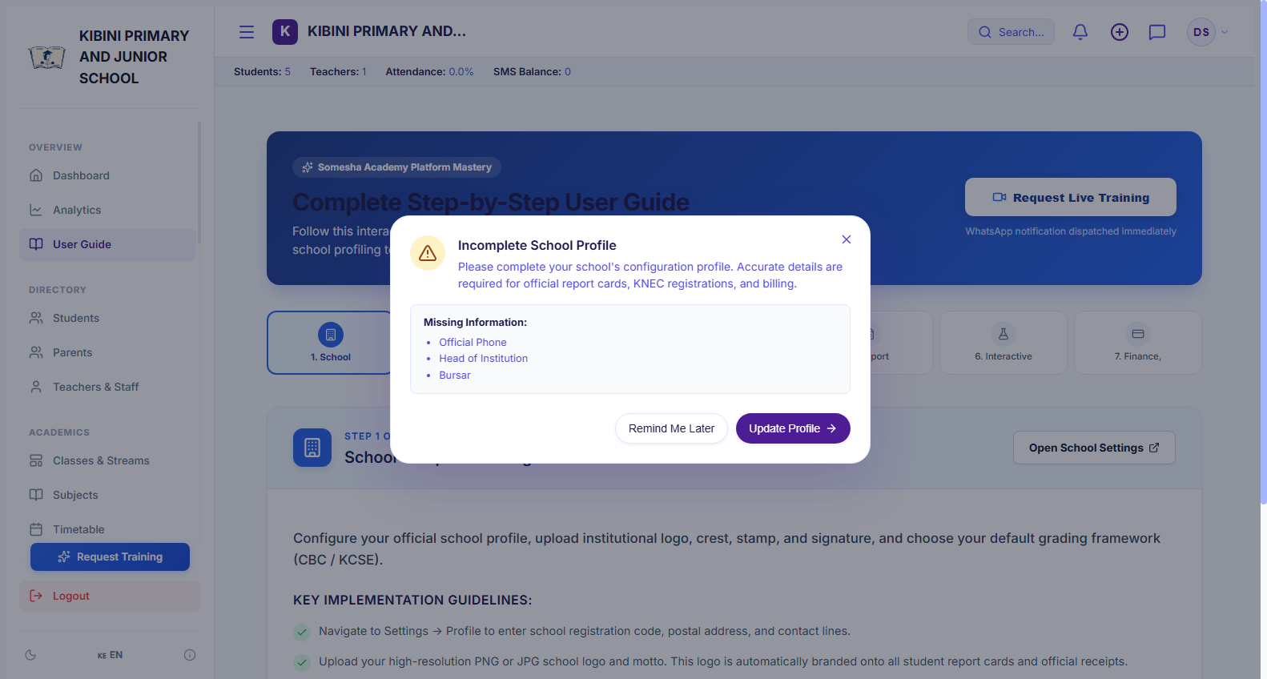
USER ONBOARDING & SUPPORT
Interactive User Guide & WhatsApp Training
Self-paced visual walkthrough and direct instant access to technical training specialists.
Step-by-Step System Walkthrough
Visual presentation covering the entire workflow: System Setup, Academics, Grading, LMS/Lab, and Reporting.
🔒 https://somesha.cloud/dashboard/guide
● Live Production
1-Click 'Request Training' Action
School administrators can book a personalized training session directly within the portal with one tap.
Instant WhatsApp Dispatch
Automatically dispatches a pre-populated training request directly to the support team's WhatsApp (+254 724 454 757).
🎯 Strategic Institutional Impact
Guarantees 100% teacher confidence and zero onboarding frustration through guided tutorials and direct personal WhatsApp assistance.
Somesha ERP Platform View • Authenticated Institution • High-Speed Cloud Database Sync

Slide 20
IMPLEMENTATION & NATIONAL ROADMAP
Transforming Kenyan Schools with Somesha ERP
A proven, turnkey 4-phase rollout ensuring seamless digital transformation across your entire institution.
Phase 1: Day 1 - 2
Institution Provisioning & SIS Import
• Self-registration & school profile configuration.
• Bulk student CSV import with NEMIS/UPI mapping.
• Teacher & administrator credential issuance.
Phase 2: Day 3 - 5
Academic Structure & CBC Setup
• Configure CBC grades (Pre-Primary, Primary, JSS).
• Assign stream allocations & class teachers.
• Set up subject competencies & grading scales.
Phase 3: Week 2
FinTech & Parent Engagement
• Safaricom Daraja M-Pesa Paybill / Till connection.
• Publish term fee structures & automated parent STK push.
• Digital noticeboard circulars & broadcast SMS.
Phase 4: Ongoing
Continuous Assessment & Reporting
• Termly formative & summative exam recording.
• 1-click CBC report card generation & PDF downloads.
• STEM Virtual Lab integration & trajectory analytics.
Get Started Today • Book a Guided Institutional Demonstration
Web: https://somesha.cloud | Support: support@somesha.cloud | Direct WhatsApp Training: +254 724 454 757

